Slide 1
The following slides were originally used within a longer session on SEND and Inclusion. They show how useful concepts from cognitive psychology can (and should) be embedded within a wider view of inclusion and a focus on responding to the whole child as a unique person. The session was developed by Emma Arblaster (SEND PGCE tutor) in discussion with Alison Lee (clinical social neuropsychologist). They found they shared a common view: Every brain is different.
SEND, working memory, receptive language, text processing for Inclusion

Slide 2
Why focus on Inclusion?
Because each of the “learning disabilities” causes a cocktail of challenges
Phonological skills
Language Processing
Memory
Sequencing
Motor Skills
Organisation
Literacy
Numeracy
Self-esteem
Behaviour
Notes:
Image: <a href="https://www.freepik.com/free-photos-vectors/party">Party vector created by macrovector - www.freepik.com</a>
People are complex and the particular needs of an individual need to be identified.
Can you think how a difficulty with one of these might affect another?

Slide 3
It is hard to diagnose
Symptoms of Irlen Syndrome
Light Sensitivity
Reading Problems
Discomfort
Attention and Concentration Problems
Writing Problems
Other Characteristics
Depth Perception
Distortions
Symptoms of Dyslexia
Poor spelling
Reading slowly or making errors when reading aloud
Visual disturbances when reading
Difficulty writing
Difficulty carrying out a sequence of directions
struggling to learn sequences,
Notes:
Teachers are not qualified to make complex diagnoses. There is overlap between what is seen in the classroom for a child with dyslexia and Meares Irlen Syndrome.
Teachers need to call on the expertise of others such as educational psychologists.
BUT also need to realise that no ‘diagnosis’ comes with a recipe for fixing a condition. Teacher need to respond creatively to meet the complex needs of the child in the context of the school.
There is lot that teachers can do to make a big difference.

Slide 4
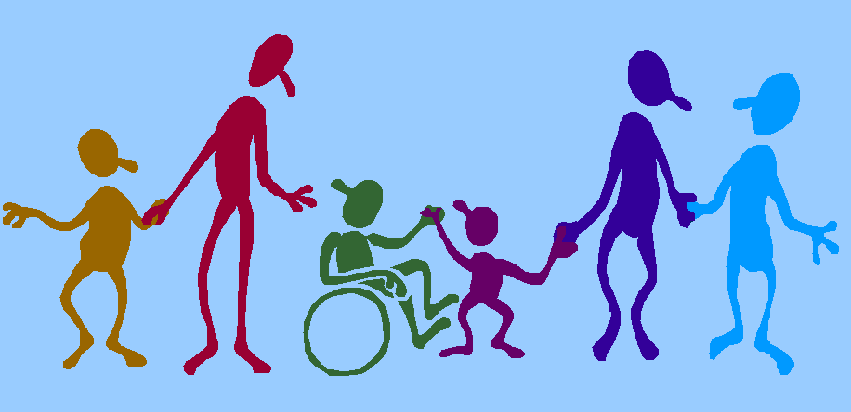
Therefore, is learning accessible to all?
If it was, what would we see? Put another way, if learning was accessible, what wouldn’t we see?
Notes:
Image from: http://clipart-library.com/special-cliparts.html

Slide 5
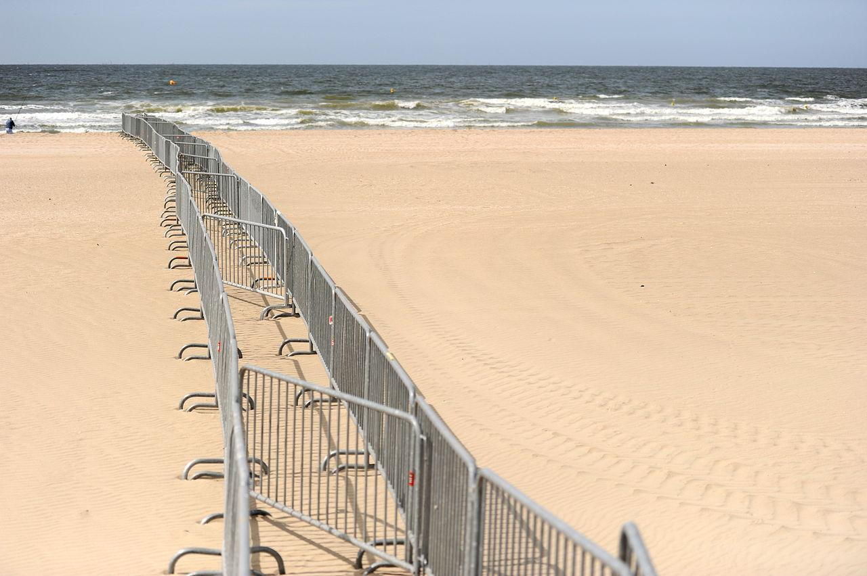
Barriers to Inclusion
pitch of learning
language used
working memory
text accessibility
room/lesson organisation
independence strategies
Really knowing the child or young person
guillaumepaumier.com, CC-BY
Notes:
https://commons.wikimedia.org/wiki/File:Crowd_control_barriers_on_the_beach_-_37th_G8_summit_in_Deauville_027.jpg

Slide 6
Top 5 strategies for inclusion
Always show unconditional, positive regard
Notes:
Image copyright free https://pxhere.com/en/photo/736153

Slide 7
Limit demands on working memory
To learn, children must transfer information from working memory (where it is consciously processed) to long-term memory (where it can be stored and later retrieved).
Children have limited working memory capacities that can be overwhelmed by tasks that are cognitively too demanding.
Understanding new ideas can be impeded if children are confronted with too much information.

Slide 8
Support Receptive Language
Watching that experiment, the car was pushed faster by Dillon than Sara. What effect did that have?
Before you can go to lunch, I want the children from the red team who wrote their letter first and the green team whose letters were about the Queen to write their first sentence on the board.
Notes:
Ask the trainees what they think about the teacher language used here.
How could it be said more clearly?

Slide 9
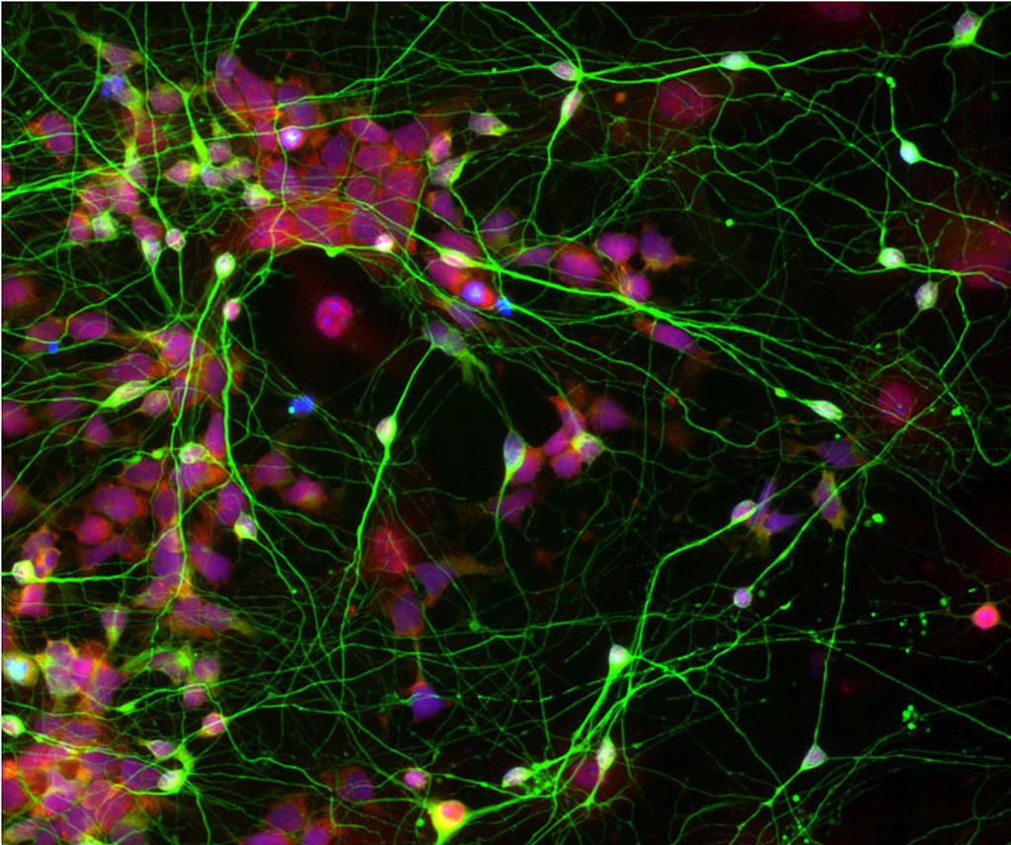
Puzzing est l’idée que les différences neurologiques comme l’autisme et de TDAH sont le résultat de la variation normale et naturelle dans le génome humain. ... science suggère des conditions comme l’autisme ont une écurie peut mesurer la prévalence dans la société humaine déjà en nous. neurodiversity on ajatus, että neurologinen eroja kuten autismi ja ADHD johtuu ihmisen genomin normaali, luonnonmukainen vaihtelua. ... tiede osoittaa, kuten autismi on vakaa esiintyvyyttä ihmisyhteisön jo vuonna voimme mitata.
Notes:
Ask trainees to read this. And then ask them to give reasons why it was difficult.

Slide 10
Give children time to understand text and to process it. Present it clearly.
Puzzing est l’idée que les différences neurologiques comme l’autisme et de TDAH sont le résultat de la variation normale et naturelle dans le génome humain. ... science suggère des conditions comme l’autisme ont une écurie peut mesurer la prévalence dans la société humaine déjà en nous. neurodiversity on ajatus, että neurologinen eroja kuten autismi ja ADHD johtuu ihmisen genomin normaali, luonnonmukainen vaihtelua. ... tiede osoittaa, kuten autismi on vakaa esiintyvyyttä ihmisyhteisön jo vuonna voimme mitata.
Notes:
Ask: How did you get on with this?
Did familiar words in the earlier section help you make sense of what you didn’t know?
Experts (and you are expert readers) often underestimate how much harder it is for beginners. Experts are unconsciously drawing on their considerable knowledge.

Slide 11
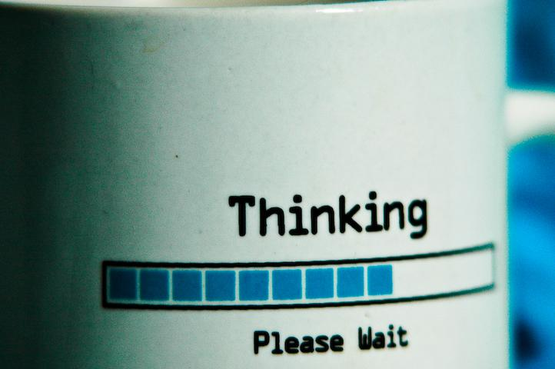
Give thinking time

Slide 12
Top 5 tips for inclusion
Always show unconditional, positive regard.
Limit demands on working memory
Support receptive language
Give time to process well presented text
Give thinking time

