Slide 1
UTILISING TECHNOLOGY TO UNLOCK THE PAST
ACAH 2017 // KOBE, JAPAN
Dr Ruth Farrar and Barney Heywood

Slide 2
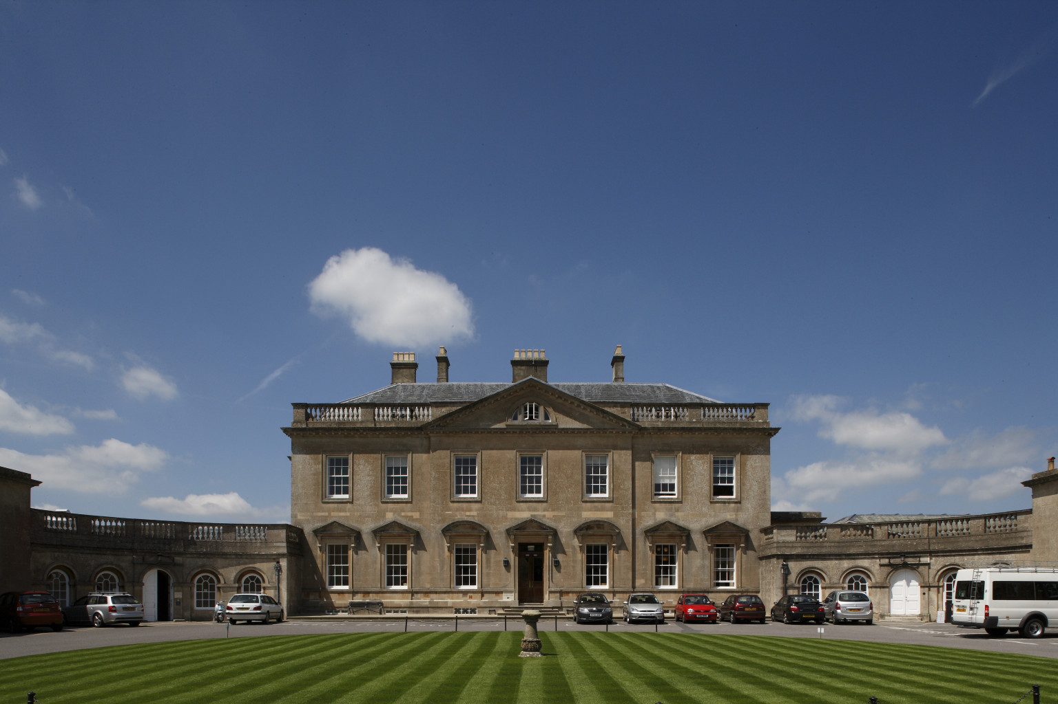

Slide 3
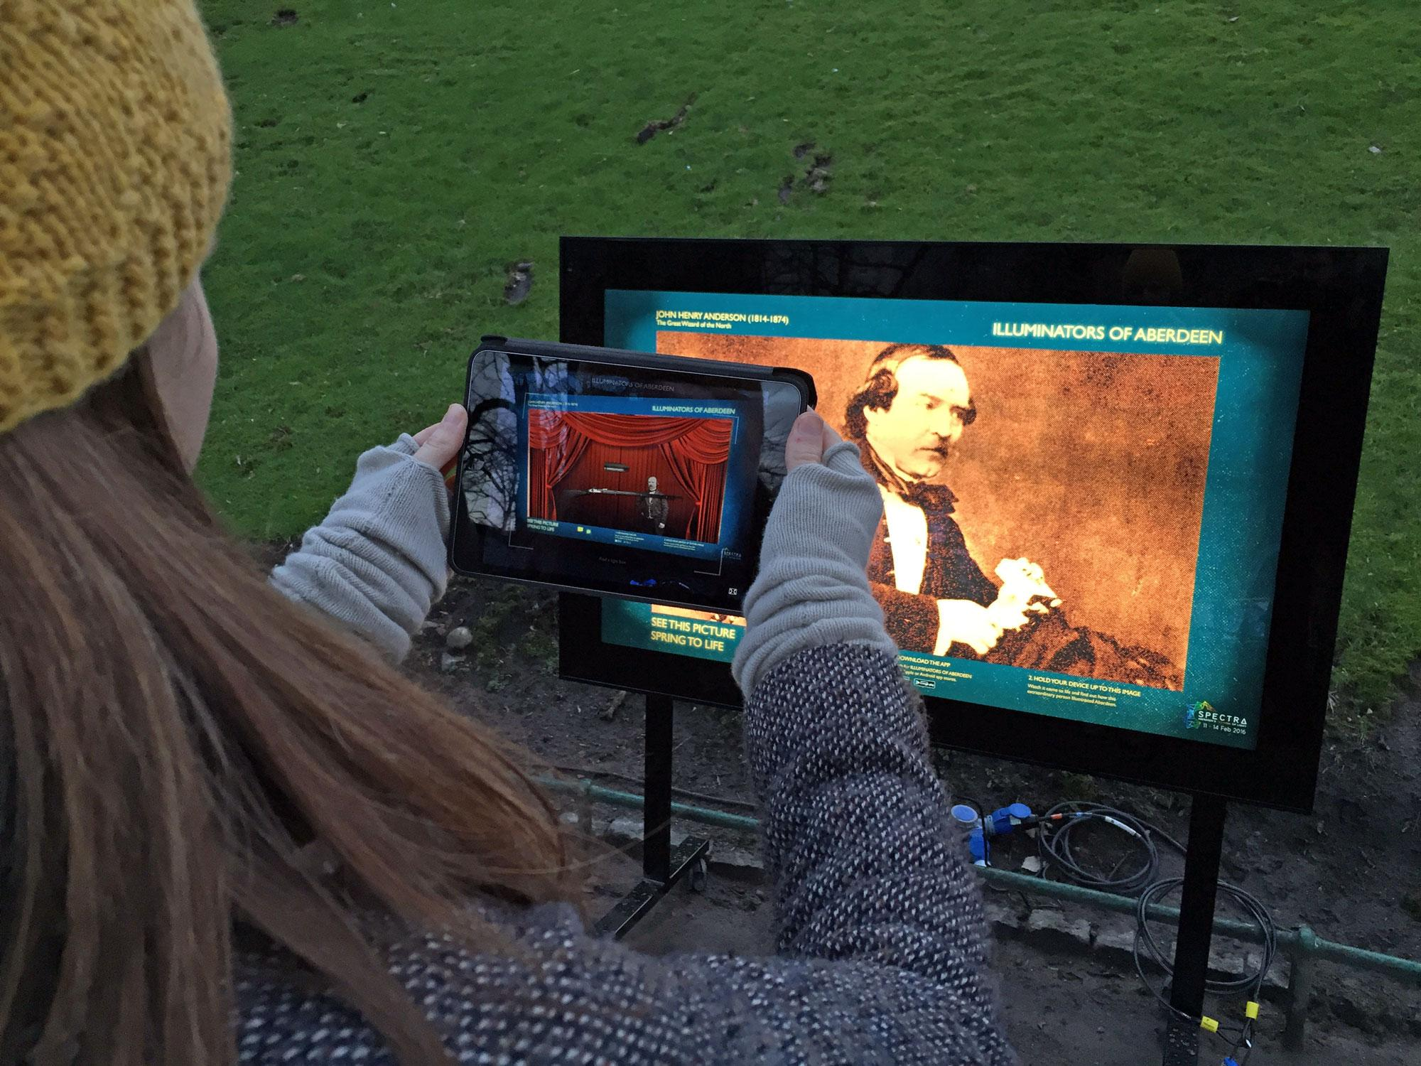
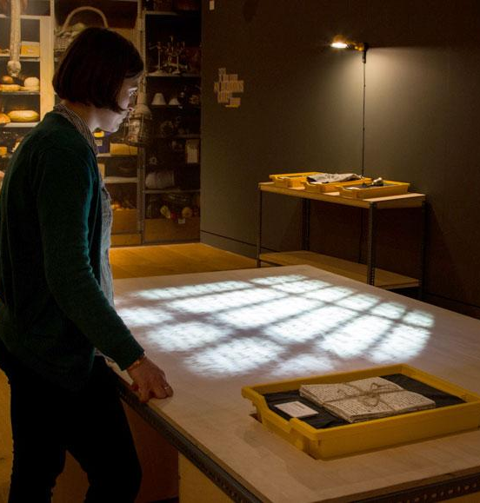
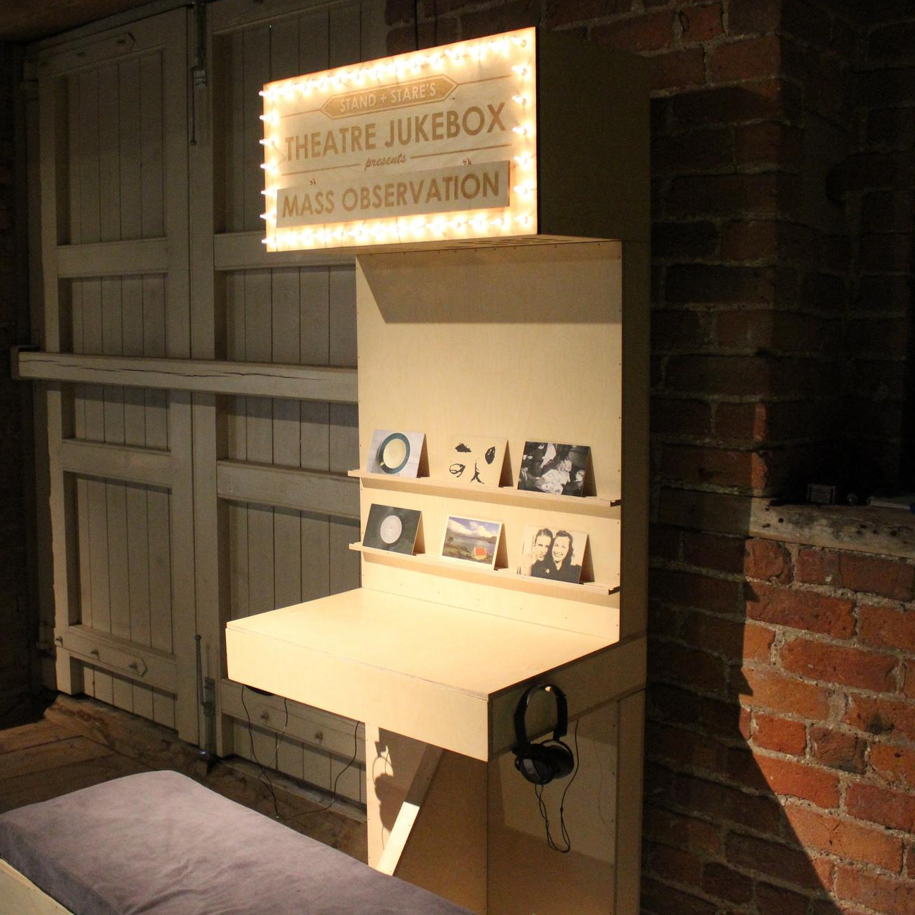
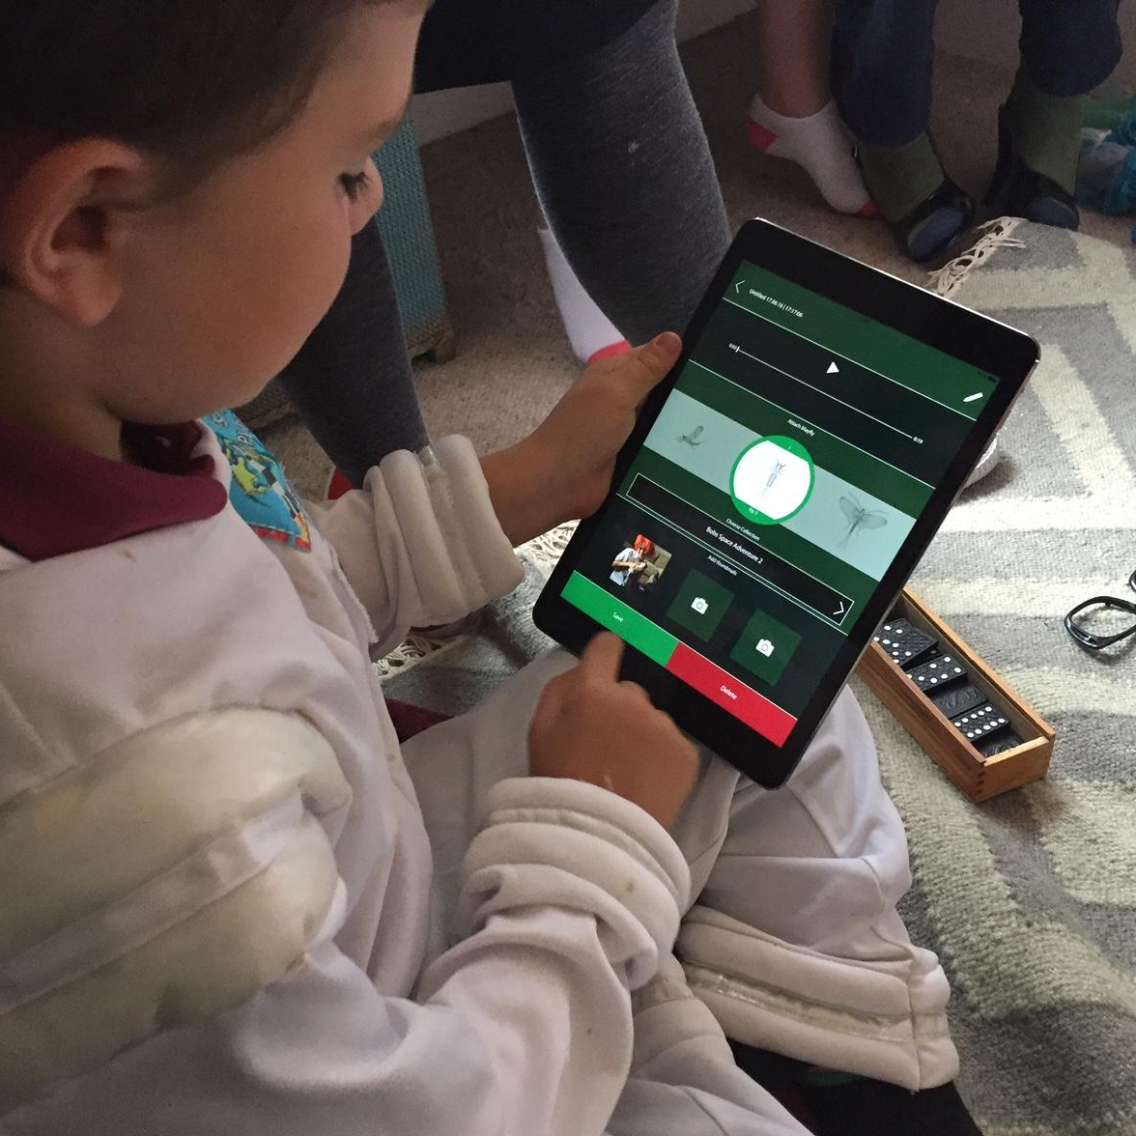
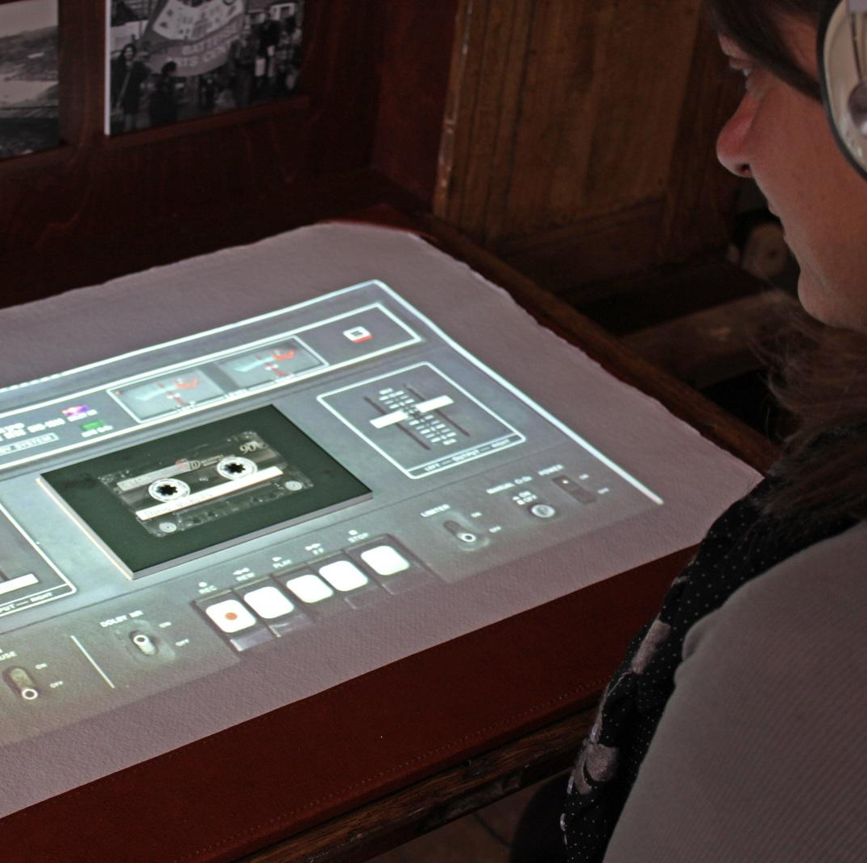
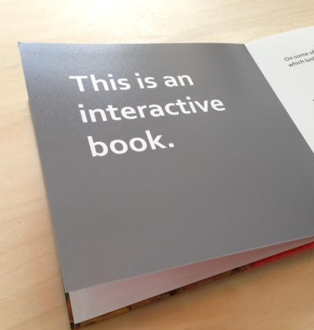
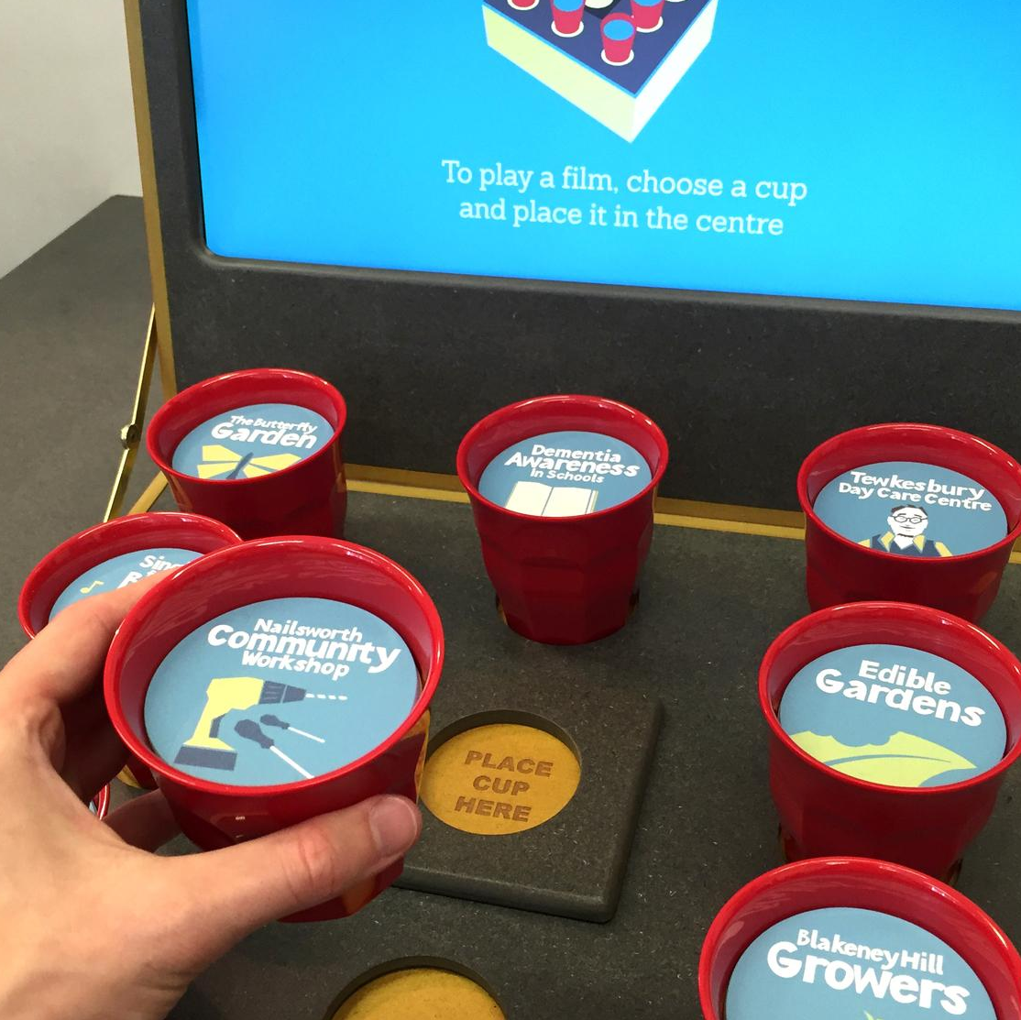
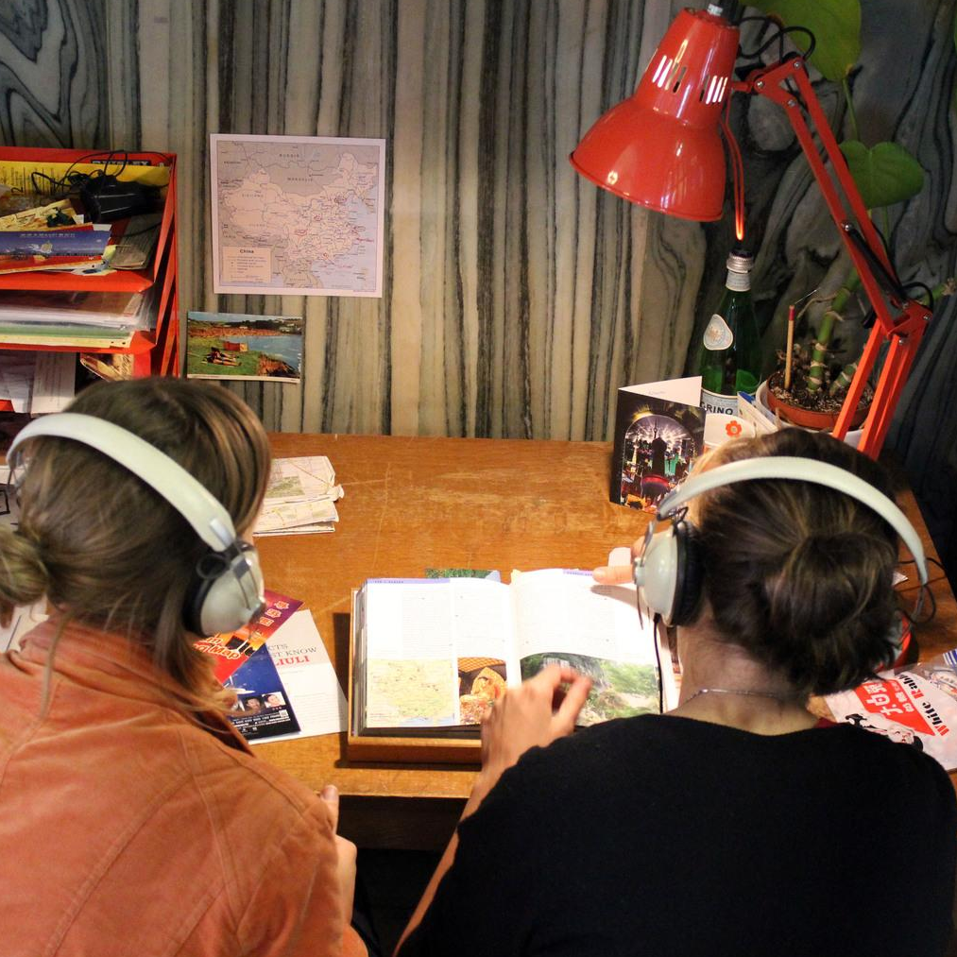

Slide 4
Key Note Interactive Speech: learning aims
To introduce the concepts of RFID and image recognition technology
To examine successful creative applications of RFID and image recognition technology within industry and practice-based research
To develop skills in using image recognition technology during an interactive task
To reflect on how to apply new skills to future research projects

Slide 5
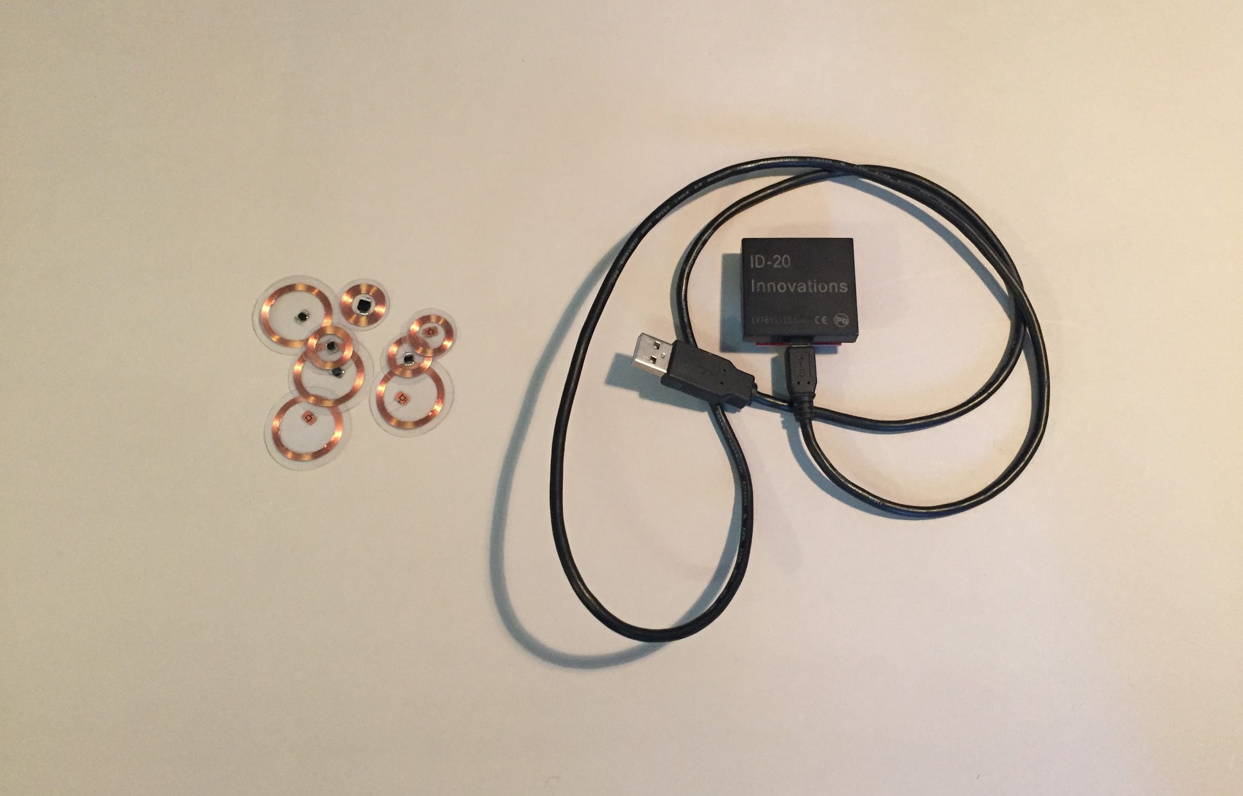
RFID: How does it work?

Slide 6
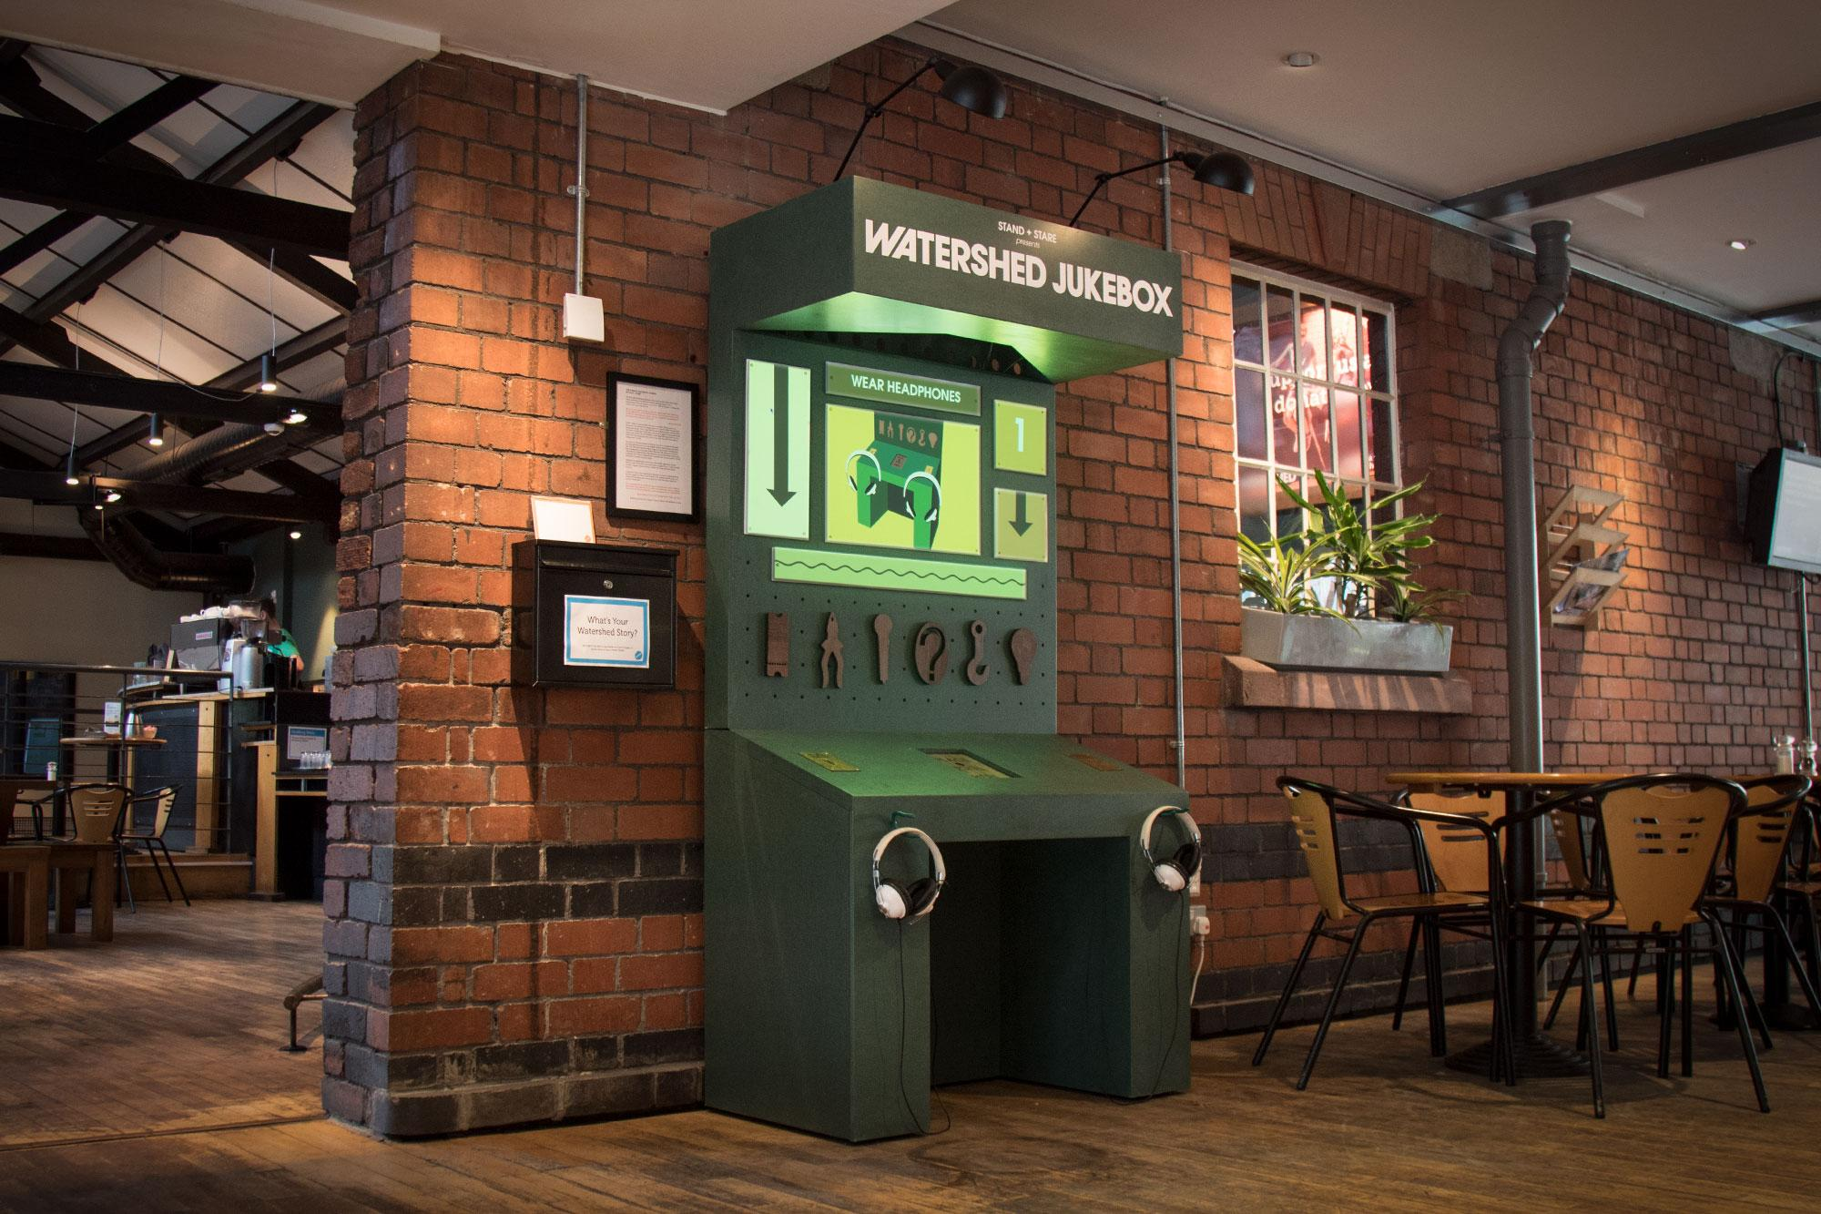
Creative Application: Theatre Jukebox

Slide 8
Image Recognition: How does it work?

Slide 10
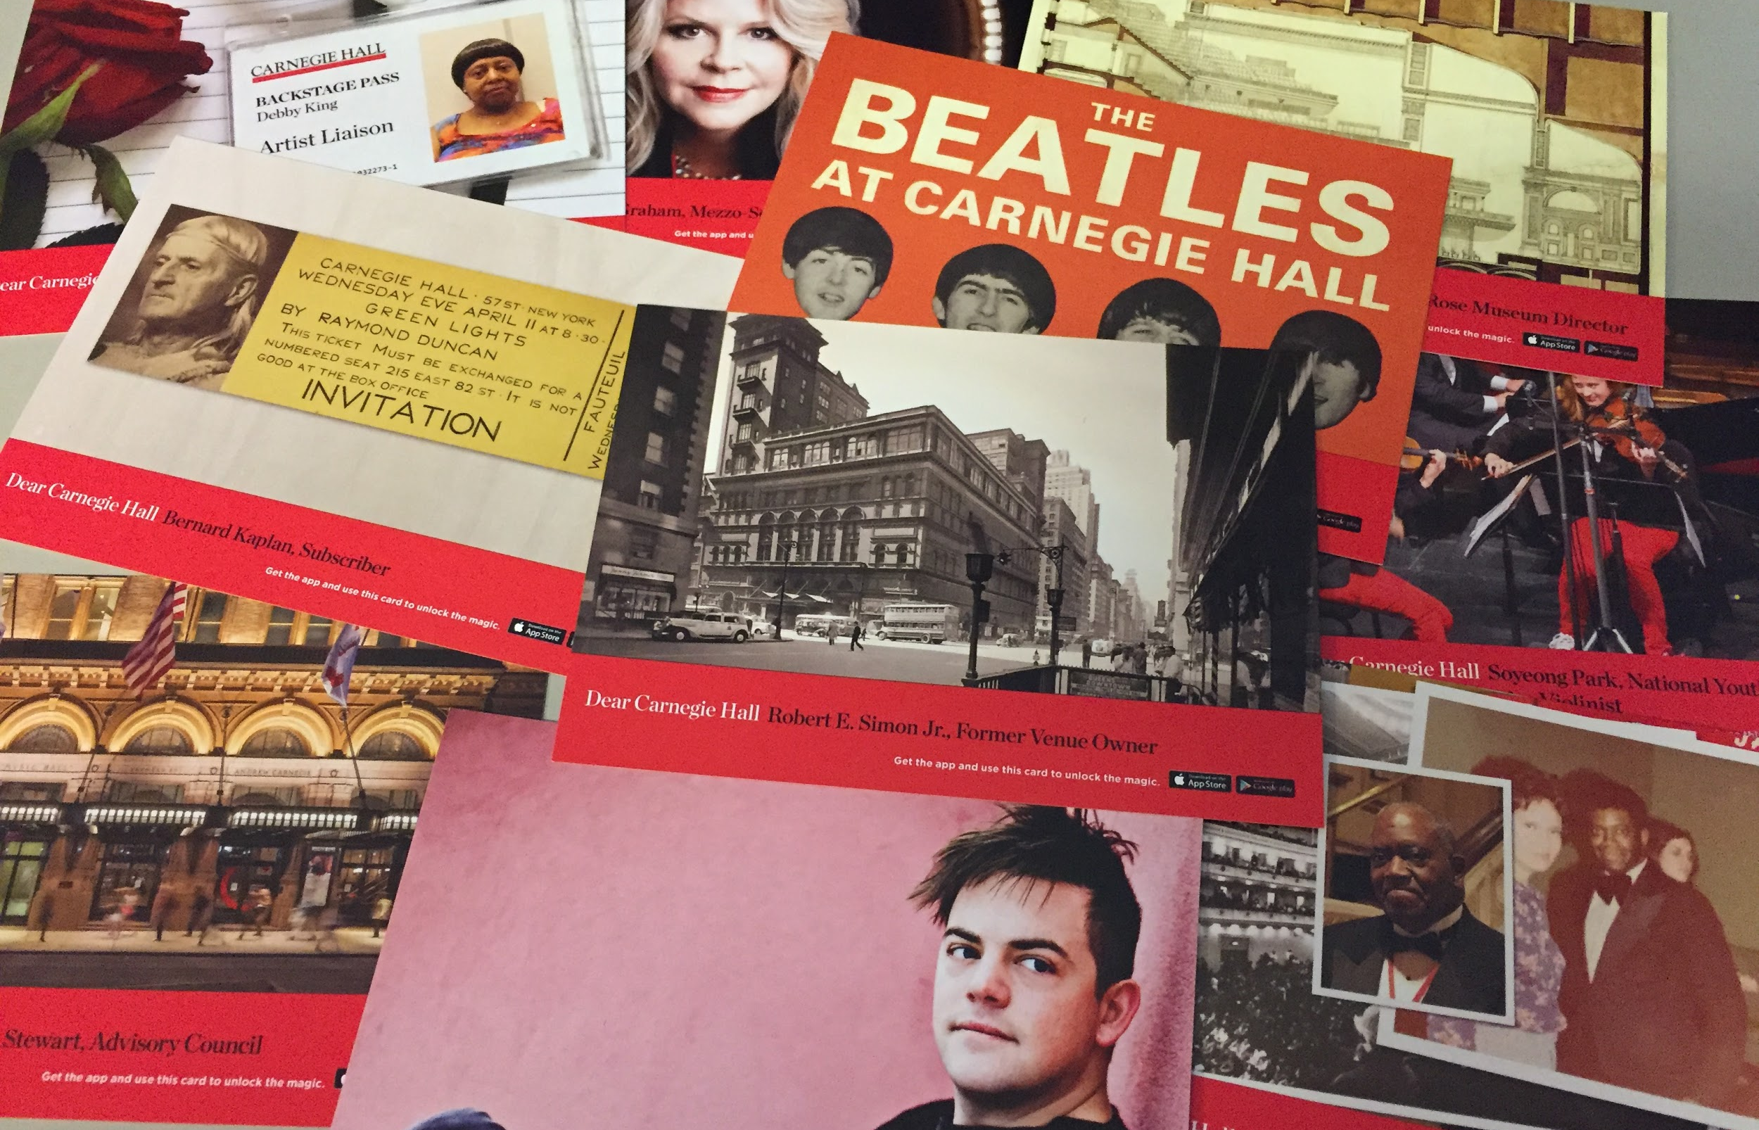
Creative Application: Dear Carnegie Hall

Slide 11
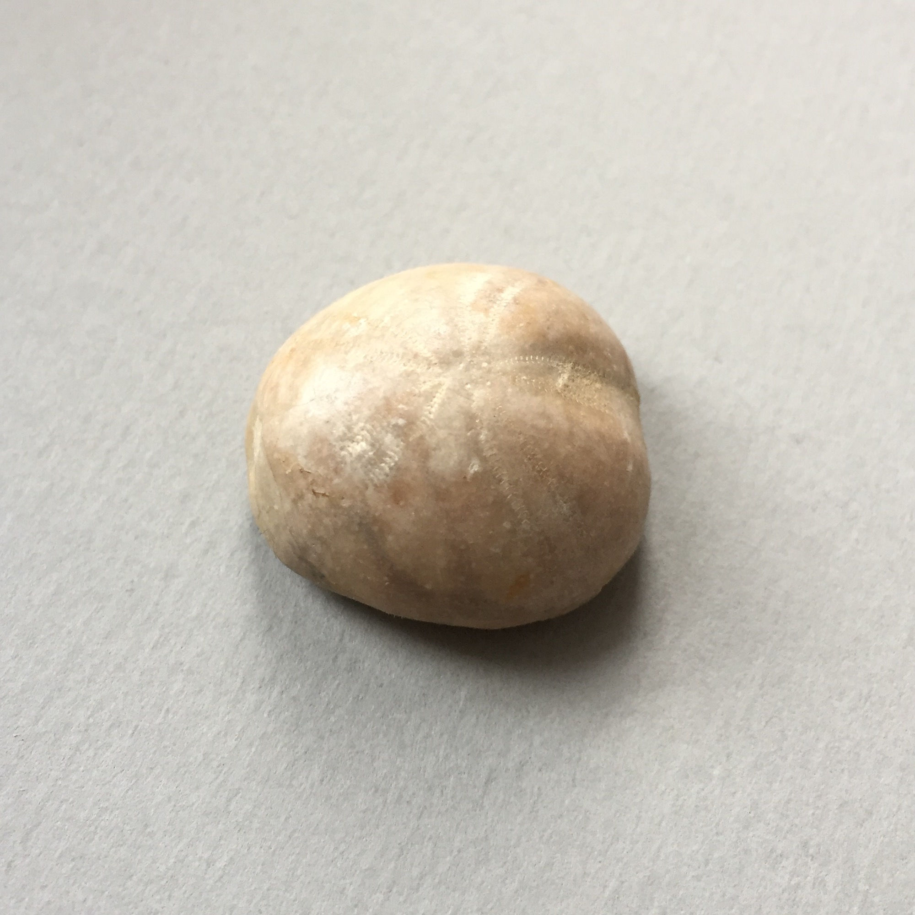
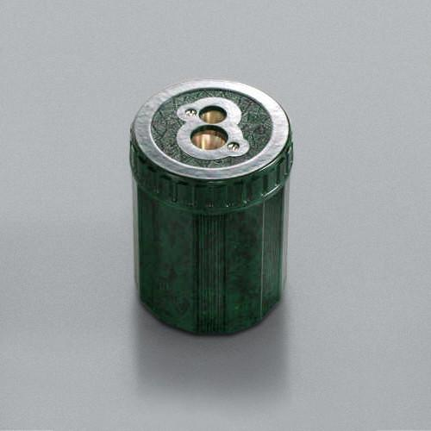
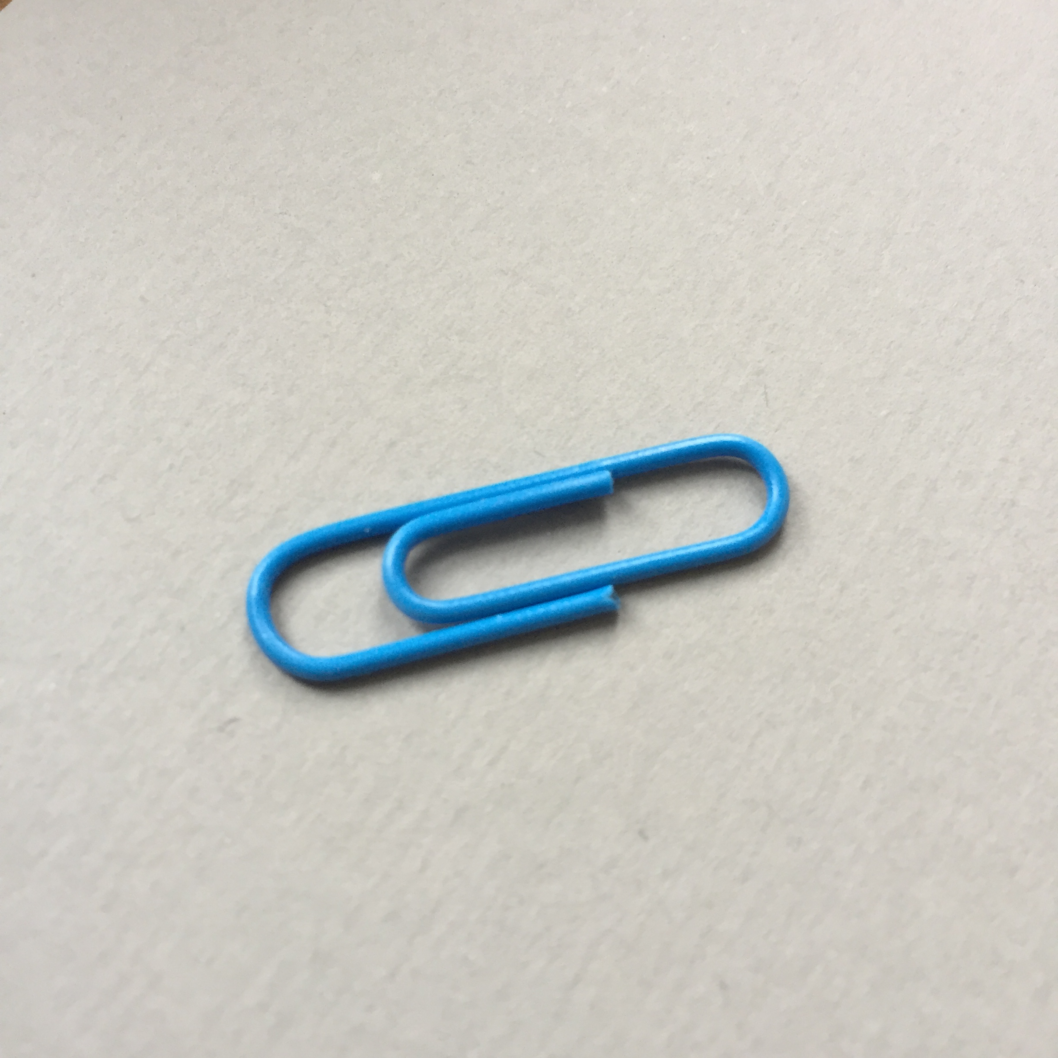
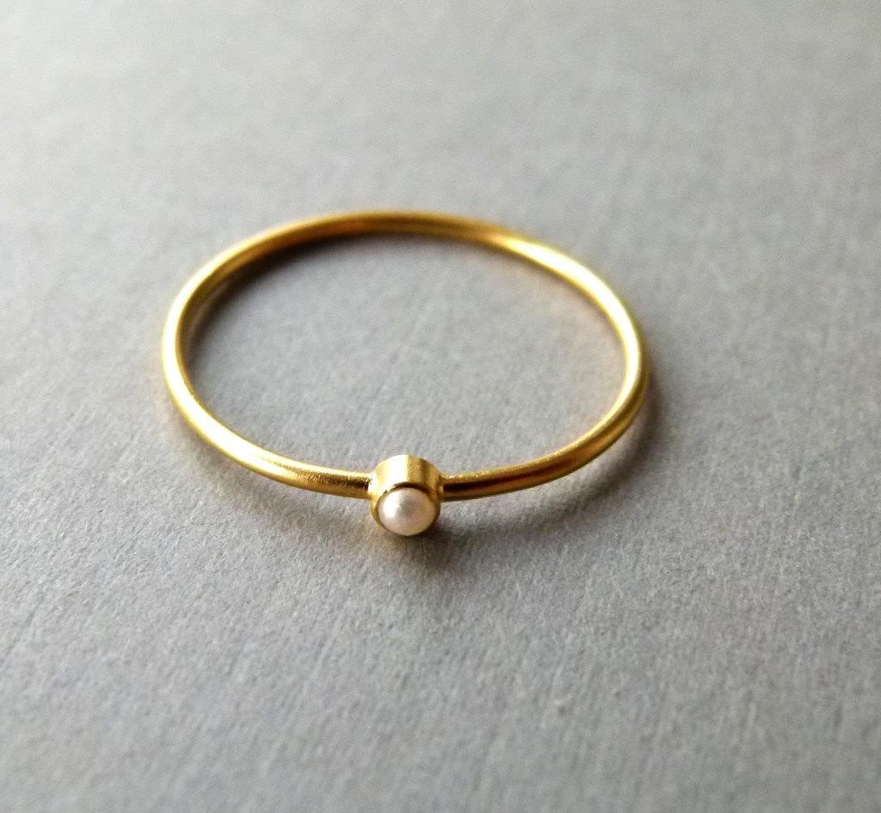
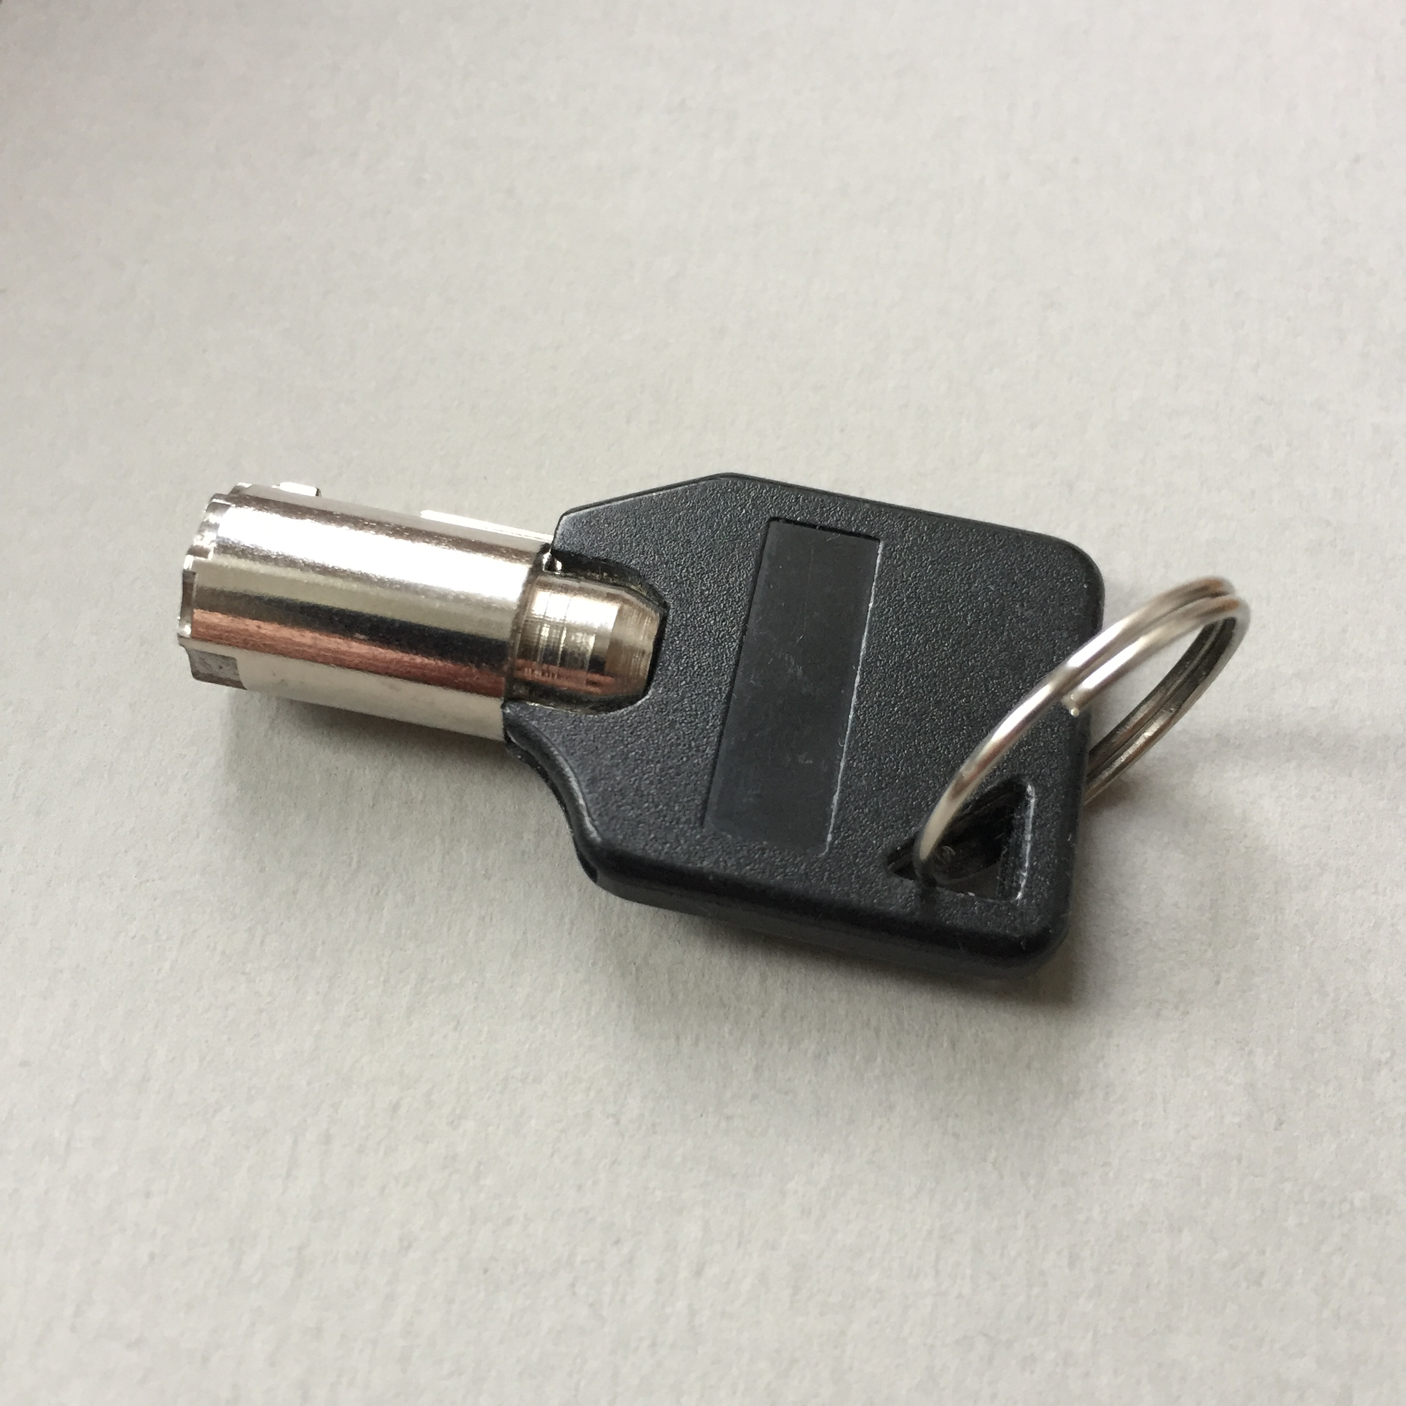
What objects do you have with you right now?
Do they remind you of a special memory, journey, person, event or place?
What story do they tell?

Slide 12
Curate an exhibition
Share your objects and stories within your larger group.
Are there any connecting themes that emerge between some of the objects?
Eg. Family, travel, home, humour…
How would you curate an exhibition using your groups objects?
Where would be the ideally location for your exhibition.
Eg. National, library, pop gallery, old peoples home...
What is the name of your group’s exhibition?
1. Agree on a connecting theme between some of your objects.
Eg. Family, travel, home, humour…
2. Name your exhibition.
3. Proposed location.
Eg. National museum, library, pop-up gallery, old peoples home..

Slide 13
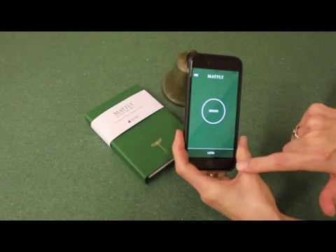

Slide 14
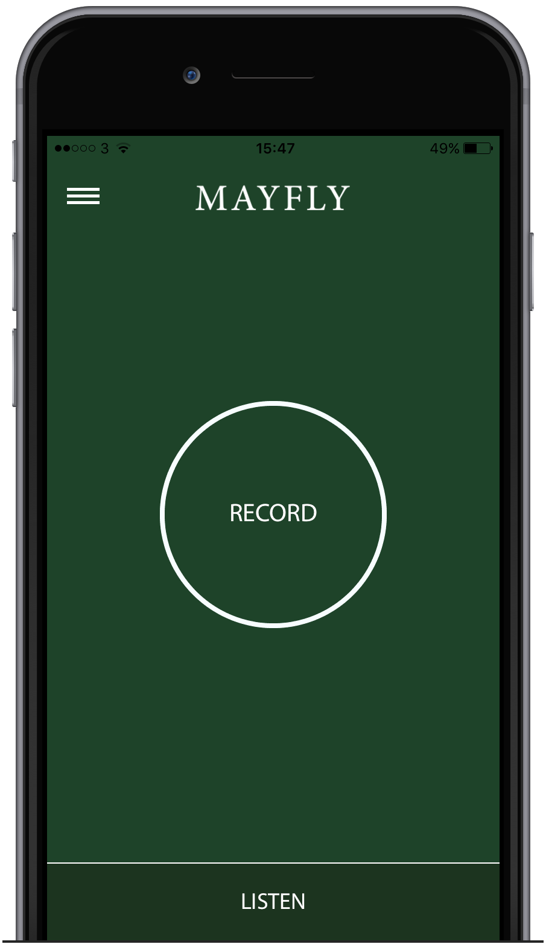
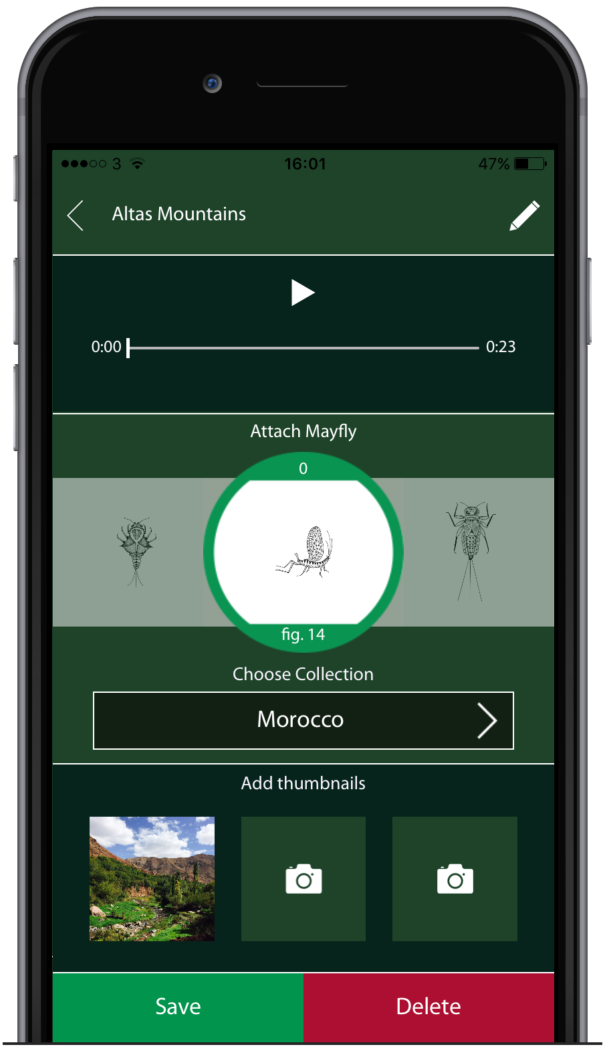
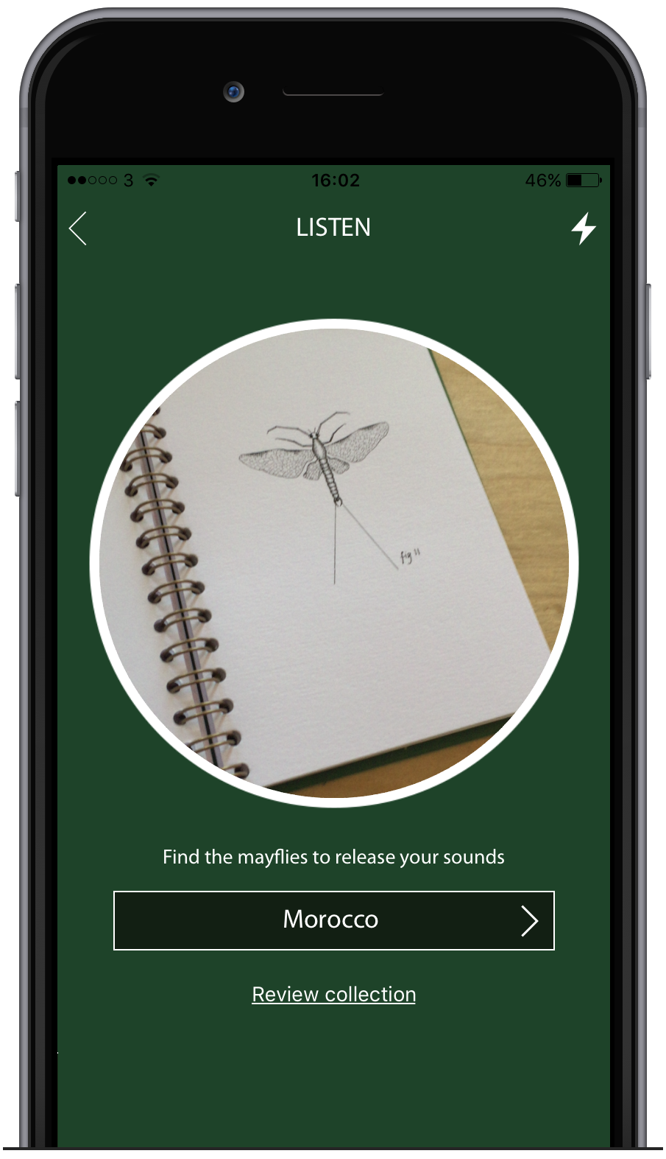
Download the Mayfly Sound App
1. Search for Mayfly Sound on Apple or Android App Stores.
2. Create an account by entering your email and password.
3. Name your collection and enter the following key code:
M4YF1Y
Record
Press the record button to start recording a sound.
Attached
Attach it to a Mayfly and add a photo of your object.
Listen
Hold your device over the mayfly to hear your sound.

Slide 15
Show & Tell
Show and tell

Slide 16
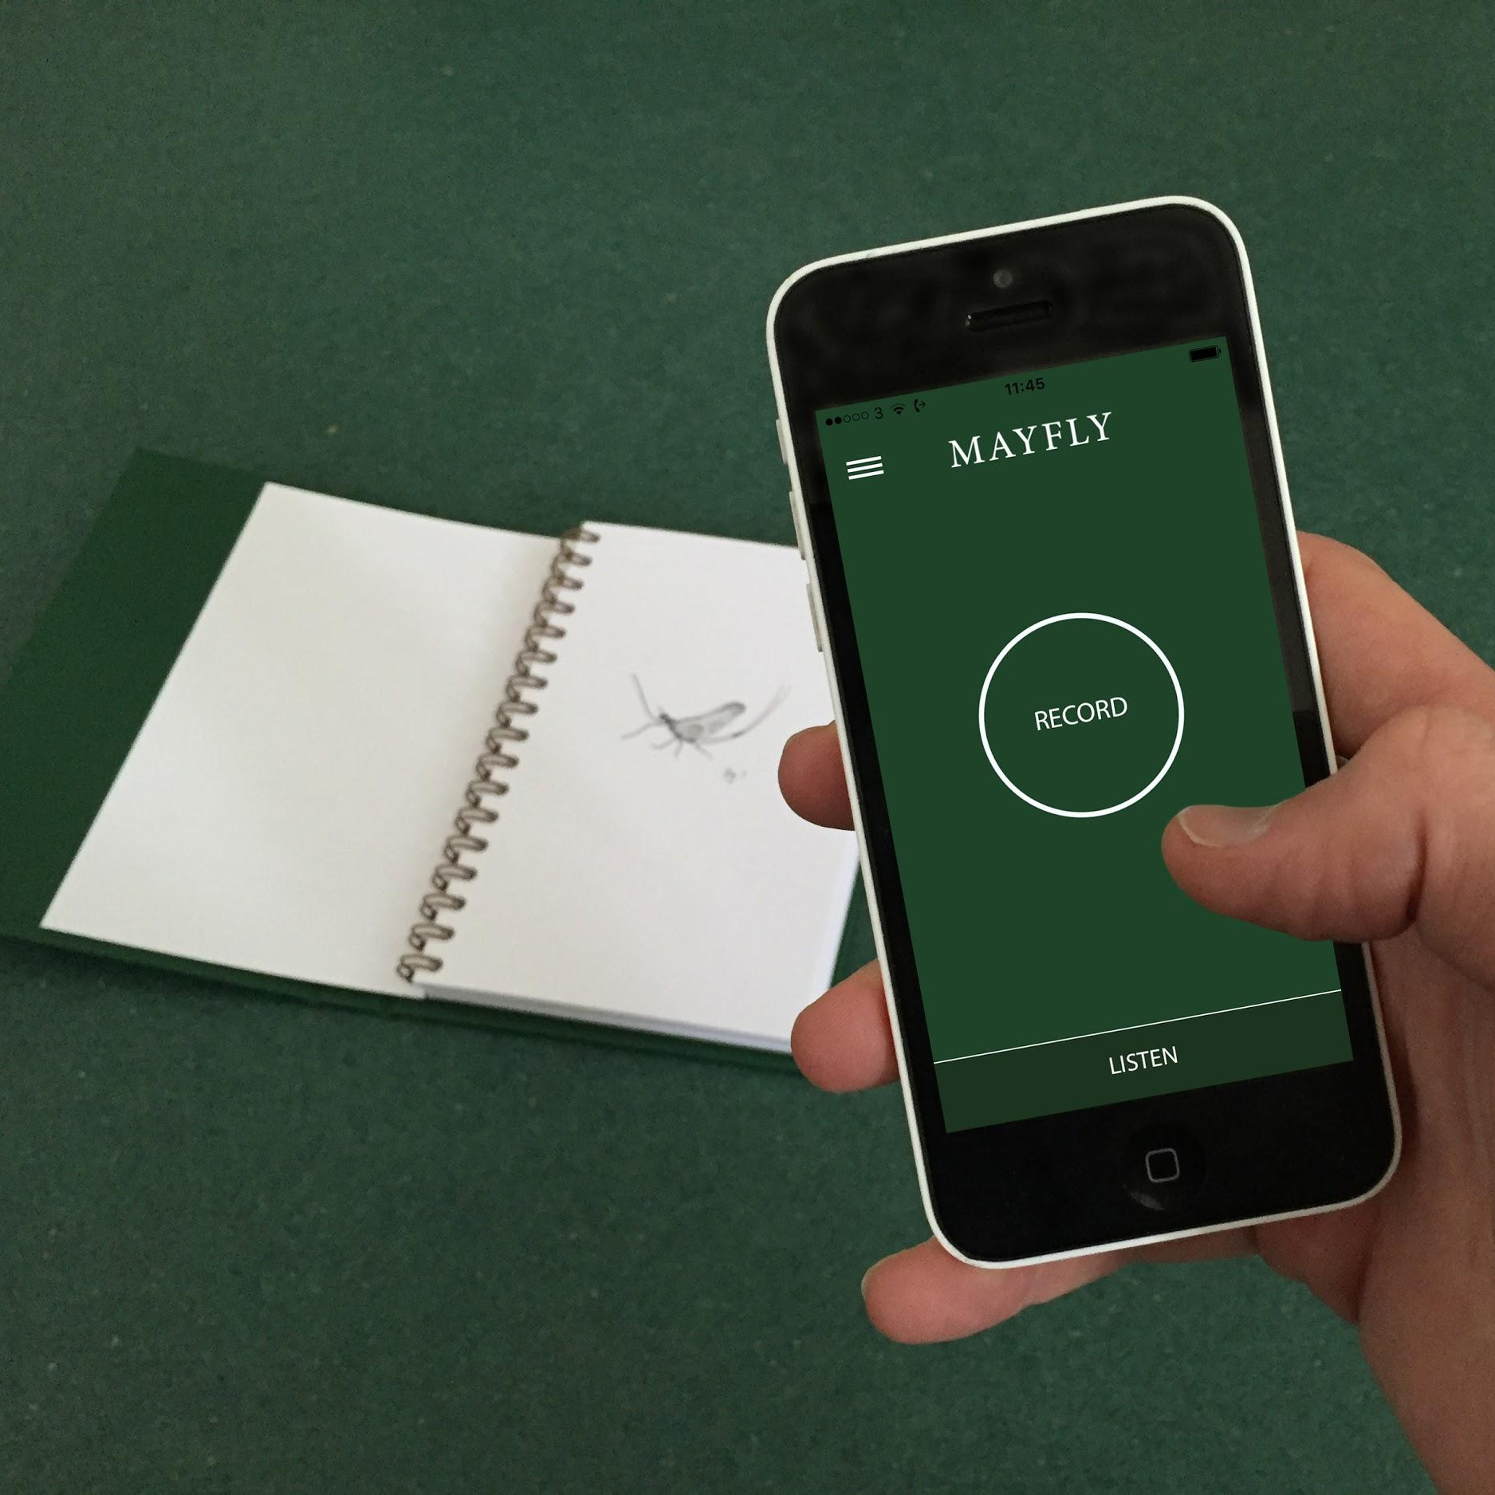
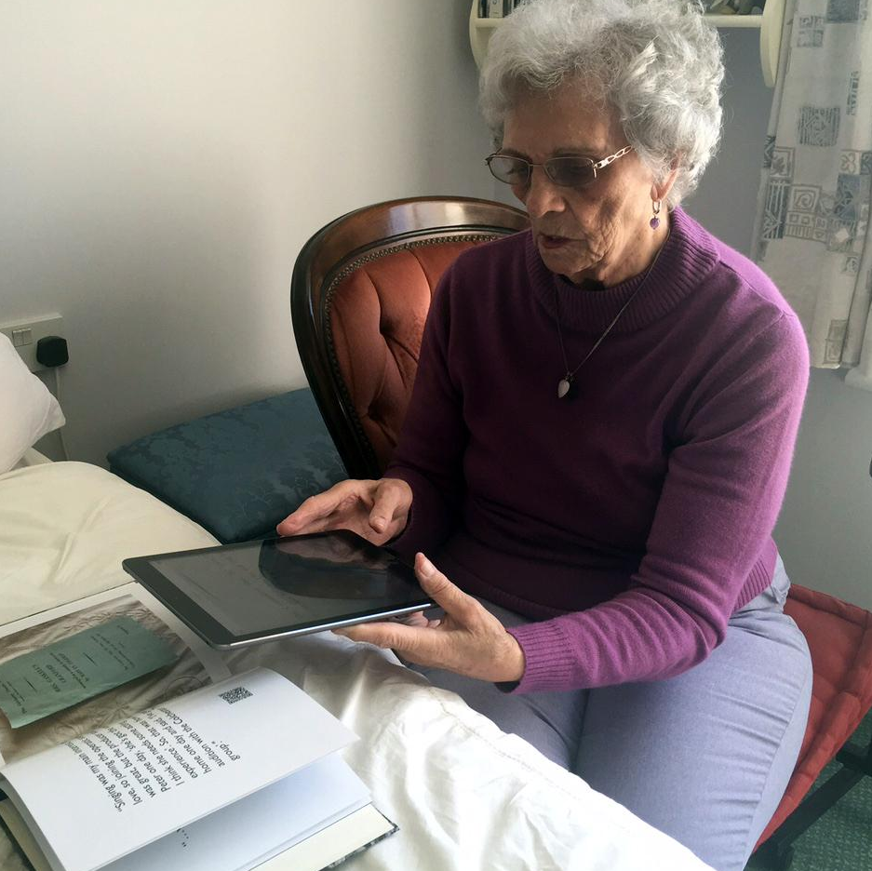
Further Applications
MAYFLY Commercial
Tangible Memories Social

Slide 17
Show and tell
How could you utilise RFID and image recognition technology to bring your research to life for new audiences and increase impact?

Slide 18
Stay in touch
Show and tell
Dr Ruth Farrar r.farrar@bathspa.ac.uk www.bathspa.ac.uk
@ruth_farrar
Barney Heywood barney@standandstare.com www.standandstare.com
@stand_stare
enquiries@mayflysound.com www.mayflysound.com
@mayflysound

