Slide 1
We’re not apathetic,
We just don’t like you!
(Grace Dyas, 2015)
Changing Lives:
Making Verbatim Theatre with & for Young People
Dr Helena Enright
23 November 2016

Slide 2
VERBATIM THEATRE
Original Definition by Derek Paget introduced to the Academy
…a form of theatre firmly predicated upon the taping and subsequent transcription of interviews with “ordinary” people, done in the context of research into a particular region, subject area, issue, event, or combination of these things. This primary source is then transformed into a text which is acted, usually by the performers who collected the material in the first place. (1987: 317)

Slide 3
Some Confusion….
From the 1990s, however, the term is applied by some informed practitioners, and more loosely and confusingly by others, to much documentary theatre, from Piscator’s model in the 1960s, to plays like My Name is Rachel Corrie (2005), based on diaries, notebooks and emails, as well as to plays which incorporate both testimony and invented material, such as Hare’s Stuff Happens and Gupta’s Gladiator Games. (Lurkhurst 2008: 203)

Slide 4
More recently defined as:
The term verbatim refers to the origins of the text spoken in the play. The words of real people are recorded or transcribed by a dramatist during an interview or research process, or are appropriated from existing records such as the transcripts of an official enquiry. They are then edited, arranged or recontextualized to form a dramatic presentation, in which actors take on the characters of the real individuals whose words are being used. (Hammond & Steward 2008: 9)

Slide 5
Testimony & The Community
“If the Greeks invented tragedy, the Romans the epistle and the Renaissance the sonnet”, then according to Elie Wiesel, “our generation invented a new literature of testimony”
(Wiesel, 9)
The closer we can get to
touching on community concerns,
to making plays that people can use,
that help them understand...
that help us understand, this community,
the better off I think we are.
Gerard Stropnicky of the Bloomsberg Theatre Ensemble, USA

Slide 6
extends beyond the boundaries of performance
My Practice:
is propelled by the belief that sharing and listening to each other’s life experiences can enrich our communities, and in turn, our lives.
Touches on community concerns
Attends to the narrative essence of testimony

Slide 7
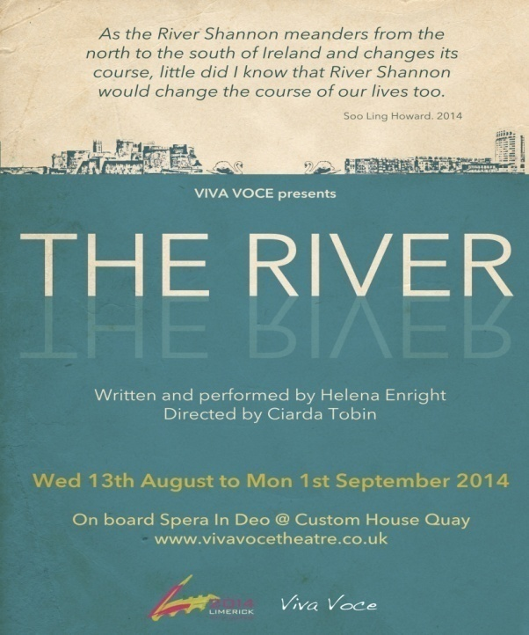
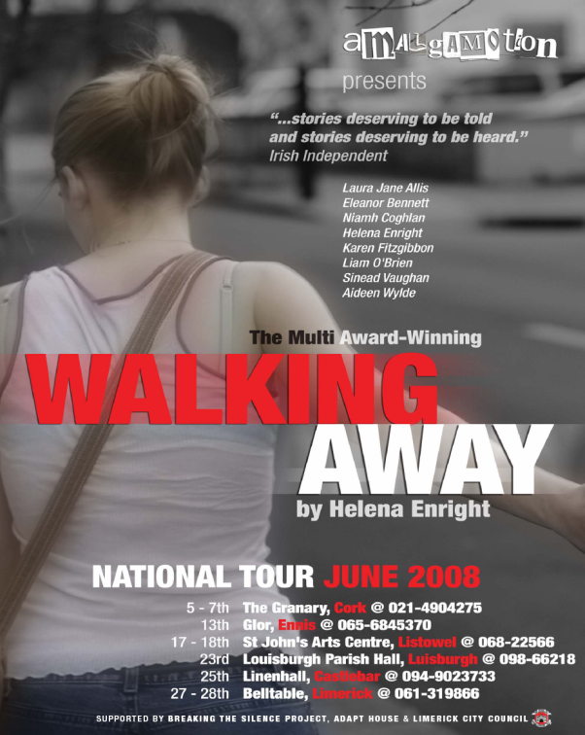
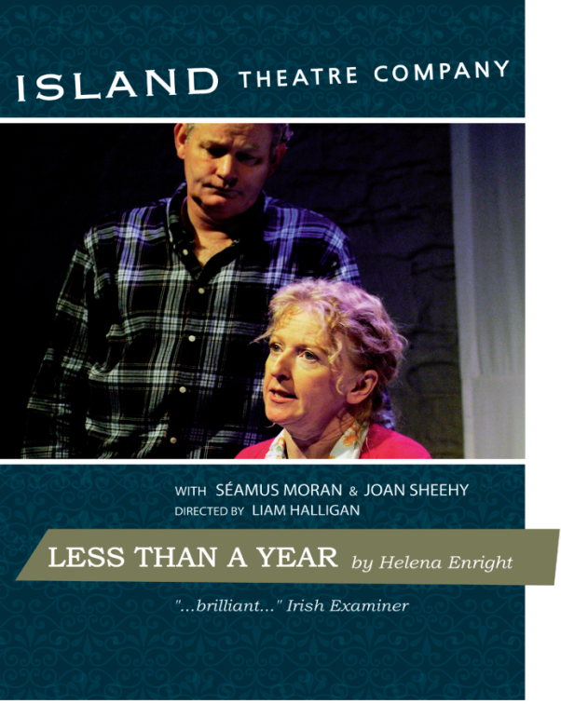

Slide 8
LESS THAN A YEAR
‘Emotive and utterly plausible.
A brilliant piece of docu-drama.’
Irish Examiner, Nov 2006
The play gains extraordinary power from its use of testimony. It is transformed from a personal story into a universal dilemma, giving the play political bite.’
Irish Times, Nov 2006
This is not the sort of theatre that falls into the category of "light entertainment", in fact arguably it is not entertainment at all but nor does it seek to educate, well not explicitly. What is does do, is deliver a story that will touch pretty well every member of the audience in one way or another, promote discussion of what is often seen as the undiscussable and, in my opinion, help people (or prepare people) to face similar life challenges.
UK Theatre Web, Jan 2011
Notes:
I did a reading of this recently at a talk on the use of testimony in theatre. A doctor and his wife were in the audience and they spoke of how this needed to be seen by every medical student in the country.

Slide 9
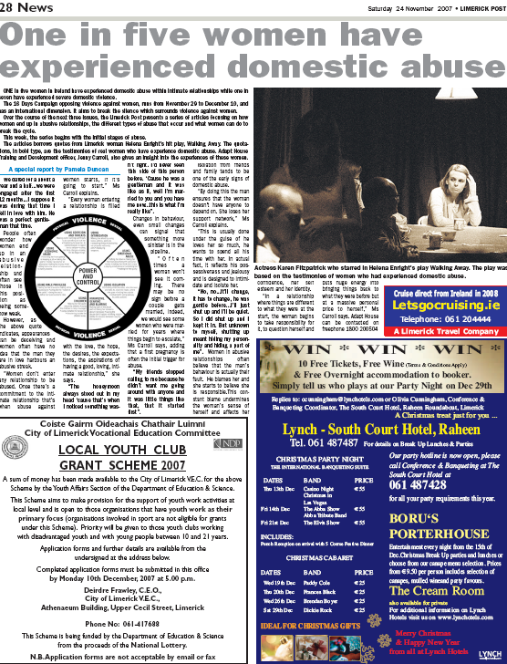
WALKING AWAY, 2008
It was like as if somebody was holding a
full-length mirror in front of me and
forcing me to look into it to see the person
that I have become. Was I really that person?
I found telling the story to you quite tough,
but when listening to the story being repeated
back to me, it was like someone pushing a
button and fast-forwarding my healing by
about two years. I could no longer deny the
abuse. (Woman 5 2007)

Slide 10
The Exeter Blitz Project, 2012
I often struggle with Verbatim Theatre but this felt different...a sharing and an exchange took place that doesn’t always happen in theatre. I felt invited in and the rawness of the touching stories were intelligently placed and subtly performed. – Natalie McGrath
“Viva Voce have produced some of the most interesting and inclusive participatory theatre in Exeter in the last year. It was incredibly moving to see older people who had told their stories about the Blitz come to The Bike Shed Theatre to see the final production and obviously demonstrate their approval of the company's interpretation. This is community participation at its best and an excellent role model for other companies” - Val Wilson, Exeter Arts Council

Slide 11
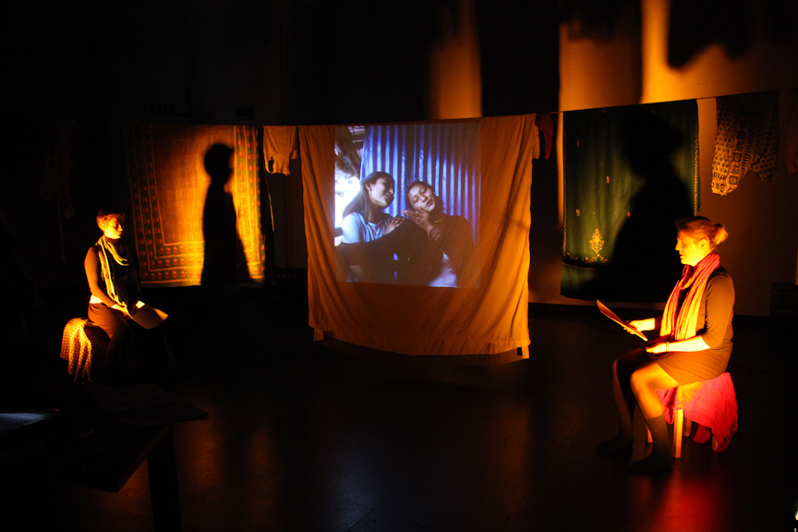
Tin Girls, 2012
"I can't tell you how much of a difference this makes for our department...We're just about to get our analytical database up and I'm going to be able to do So much with it to map traffickers. I can stay on to train my replacement - this will be a HUGE help to our organization! Thank you everyone for your support.” – Alex Robinson
All proceeds from the production were donated to
Alex Robinson at Tiny Hands, to enable her to continue her work with police and border control to create databases to catch traffickers.

Slide 12
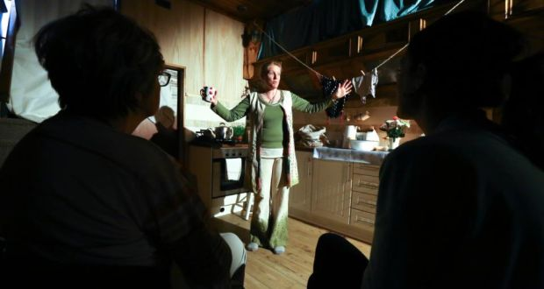
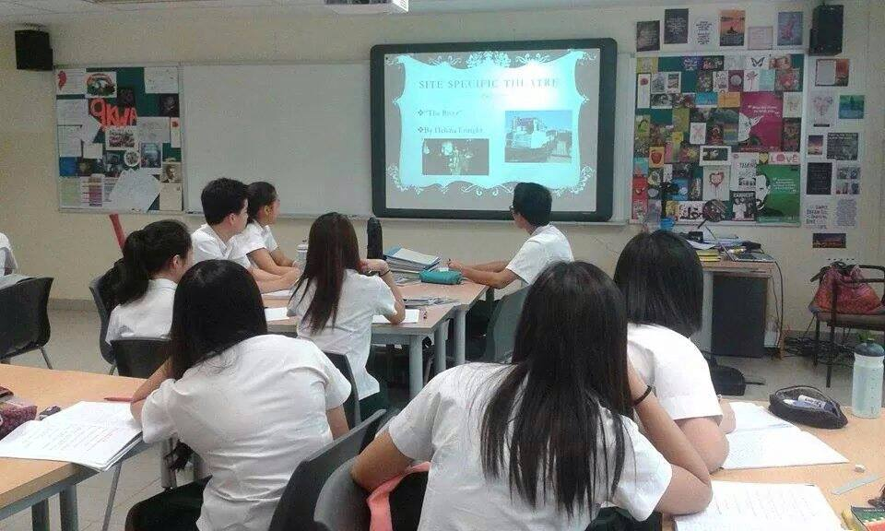
The River, 2014
...so fabulous, thank you Helena, for having the foresight to so diligently collect this wonderful social history and the artistic vision to represent it so truthfully and with such empathy and care. I was brought to tears. (even though i was scared that my mom might interrupt you and join the conversation....so immersed was she in the reality you brought to life!!) – Dr Annmarie Ryan, University of Limerick
Last weekend my wife, her sister and I went to see to see The River. We loved it, it was Brill. As the week passed, I have been thinking of the great times spent in my youth on the river Shannon all good... We were so privileged to have had the Shannon and our father to show us how to enjoy it. I now live on the side of a mountain looking out over the most Westerly part of Europe, Ballyferriter, West Kerry, and since the play The River I can feel the power of the Shannon, as the tide plunges in to it and then ebbs out past me. Thank you Helena Enright. – Pat Lawless, Contributor

Slide 13
Creating a Performance Using Testimony

Slide 14
Seeking the testimony of a witness in order to dramatise it involves a different level of commitment from all parts of the theatrical communication circuit to that required in a freely imagined work’
(Derek Paget 2009: 236).

Slide 15
INTERVIEWING

Slide 16
INTERVIEWING – some things to consider
Who do you want to interview and why?
What do you want to find out?
What type of interview will it be?
How will you contact them?
What is reasonable within your timeframe?
How will you record the interviews?

Slide 17
CHALLENGES:
Balancing the CREATIVE with the ETHICAL
Finding the appropriate Theatrical Frame
Capturing the Aesthetic of Memory
What story do we want to tell and how do we do it?

Slide 18
Ethics

Slide 19
As cultural workers, whether we are researchers writing about individuals, theatre makers constructing narratives and stories, or facilitators enabling people to write or perform their own stories, we have a responsibility towards ensuring that the representations that are made are produced through a climate of sensitivity, dialogue, respect and willingness for reciprocity.
(Sheila Preston, 2009: 65)

Slide 20
Things to consider…
Ensure you inform participants of the nature of their involvement
How you intend to use their words
Be honest with them about your intentions
Being clear about whose testimonies you are using and why will help you answer the above questions.

Slide 21
4 Rules – Robin Soans
Don’t try to write a political play.
Always look for detail, the minutiae of people’s lives.
*Never forget it’s someone’s life.*
Never pre-judge.
Notes:
If you do, it’ll end up as agit-prop – worthy, one dimensional and boring. If on the other hand, you write a humanitarian play, it has every chance of being funny, moving and political.
If people are letting you into their lives, you should treat them with the respect they deserve.
The less prejudiced you are when you arrive – the more likely you are to write a faithful account.

Slide 22
Digging Up Stories: Applied Theatre, Performance and War,
‘theatre projects that dig up narratives, experiences and remembrances’ must be treated with extreme care as they can ‘blame, enact revenge, and foster animosity as much as they can develop dialogue, respect or comfort’ (Thompson, 2005: 25-26).

Slide 23
Dramatic Structure

Slide 24
Writing the Script
Select, Arrange and Edit the Material
Decide on characters
Characters dialogue comes from the interview texts.
Apply a Narrative
Decide on stage setting to present the material.

Slide 26
The Material
THE TESTIMONY
Interviews with artists, activists, politicians
Cast members interviews
Excerpts from cast members diaries
FROM THE ARCHIVE:
Writings & articles from the 1916 Revolutionaries
Poems
Newspaper Articles
Philosophical Writings
Cast members interviews
Cast members diaries

Slide 27
Daily Rehearsal Process
Begin with:
Middle:
End with:
1 Hour physical/ensemble warm up
Step into the circle
Check into their body
Walk around the room
Alexander Technique relaxation
Exploration
of the
various material through reading and various improv exercises
Daily Protest
Education
Animal rights
Black lives matter
Abortion
Syria/ refugee crisis
Busking

Slide 28
Post Improv Discussion
What did you see happening in this scene?
NO JUDGEMENT JUST OBSERVATION
Not what worked or didn’t work
What you liked or didn’t like
RATHER
WHAT DID YOU SEE?
WHAT WAS STRIKING ABOUT THIS SCENE?

Slide 29
Engaging the young people: 3 People 3 Questions
What do you believe in?
Have you ever been moved to protest about something?
Can you tell me about a song that marked a particular time in your life?

Slide 32
WOULD YOU DIE FOR IRELAND ?

Slide 33
Extract from young person’s diary
every day there's a more terrible thing to protest against, Israel, Syria, animal abuse, eighth amendment, kids getting bullied by teachers, innocent people being killed by police every day in America and there's so much more we haven't touched on yet, the slave labour that makes our clothes and products, the farmers that are paid nothing for our food while corporations take our money, elderly people being abused in nursing homes, sex and drug trafficking supported by Petty drug purchases that we make like it literally never fucking ends and it’s hopeless there's only 20 of us the whole world should be protesting, should be angry and yet it's just a few of us, a couple thousand people at most at a time who decide to care but quickly return to their lives after they've done their day of righteous outrage, we're not better than them were the same because we're human but fuck it's depressing

Slide 34
Let the material guide the way…
It is important to spend time with your material as this will often dictate the dramatic form.
What were the circumstances surrounding the gathering – are these relevant to the story you want to tell
Or
Is it something that the material reveals or is inherent in the material?

Slide 35
THE SCRIPT
In the beginning
Political awakening
Doing something
We only want the earth
Activism
A new wave
Amendment
In the name of my country
Extremism
The way forward
WHO?
WHAT?
WHERE?
WHEN?
WHY?
IN THE BEGINNING…

Slide 36
Telling someone else’s story…
Storytelling V’s Acting
Is there a difference?
You are not acting – you are really telling this story
Be present with story
Remember the emotion that someone experiences during an event will not be the same as the emotion that they experience when they are recalling the event

Slide 37
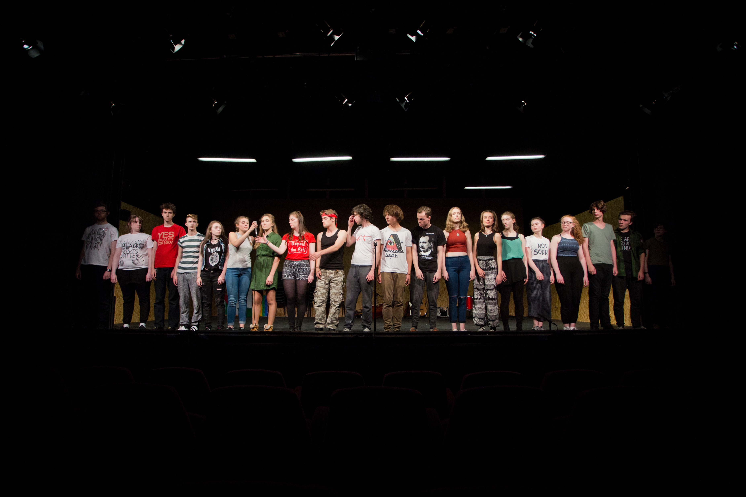

Slide 38
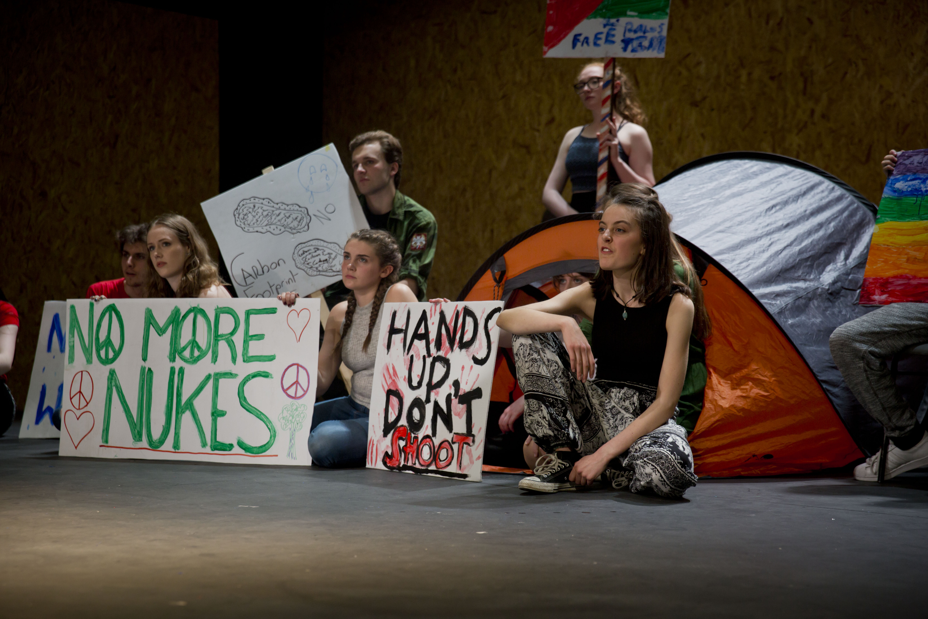

Slide 39
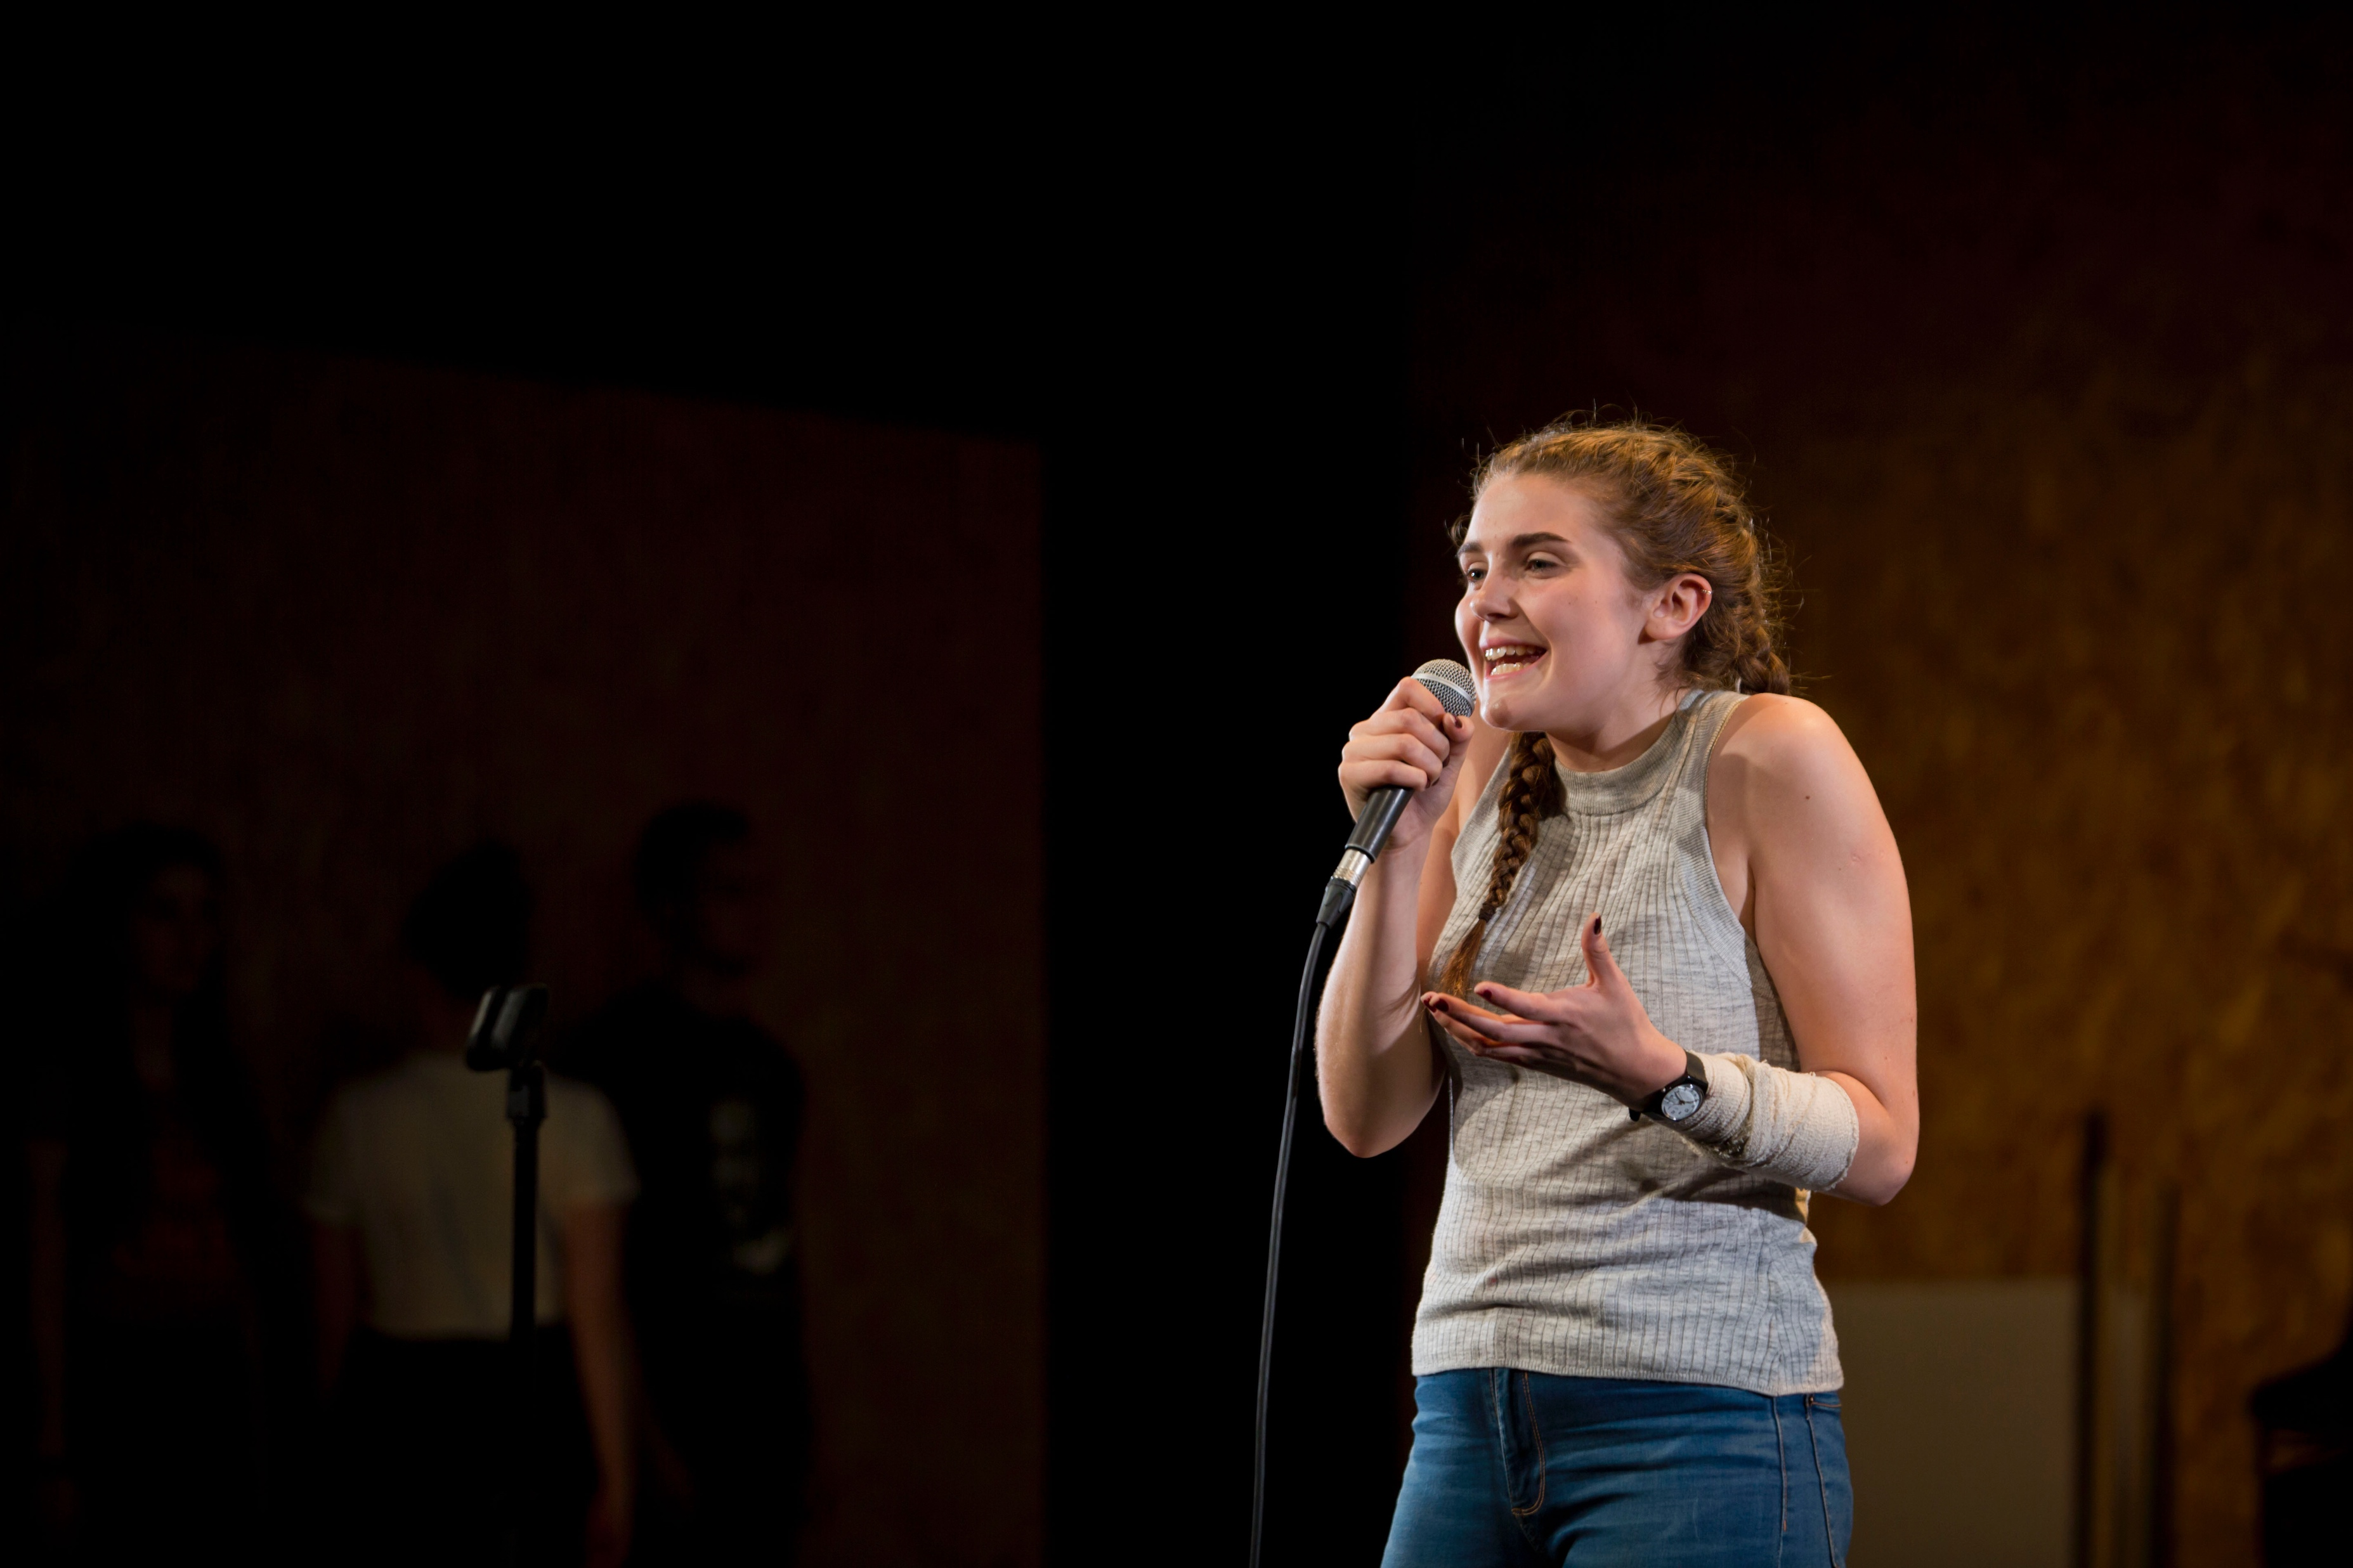

Slide 40
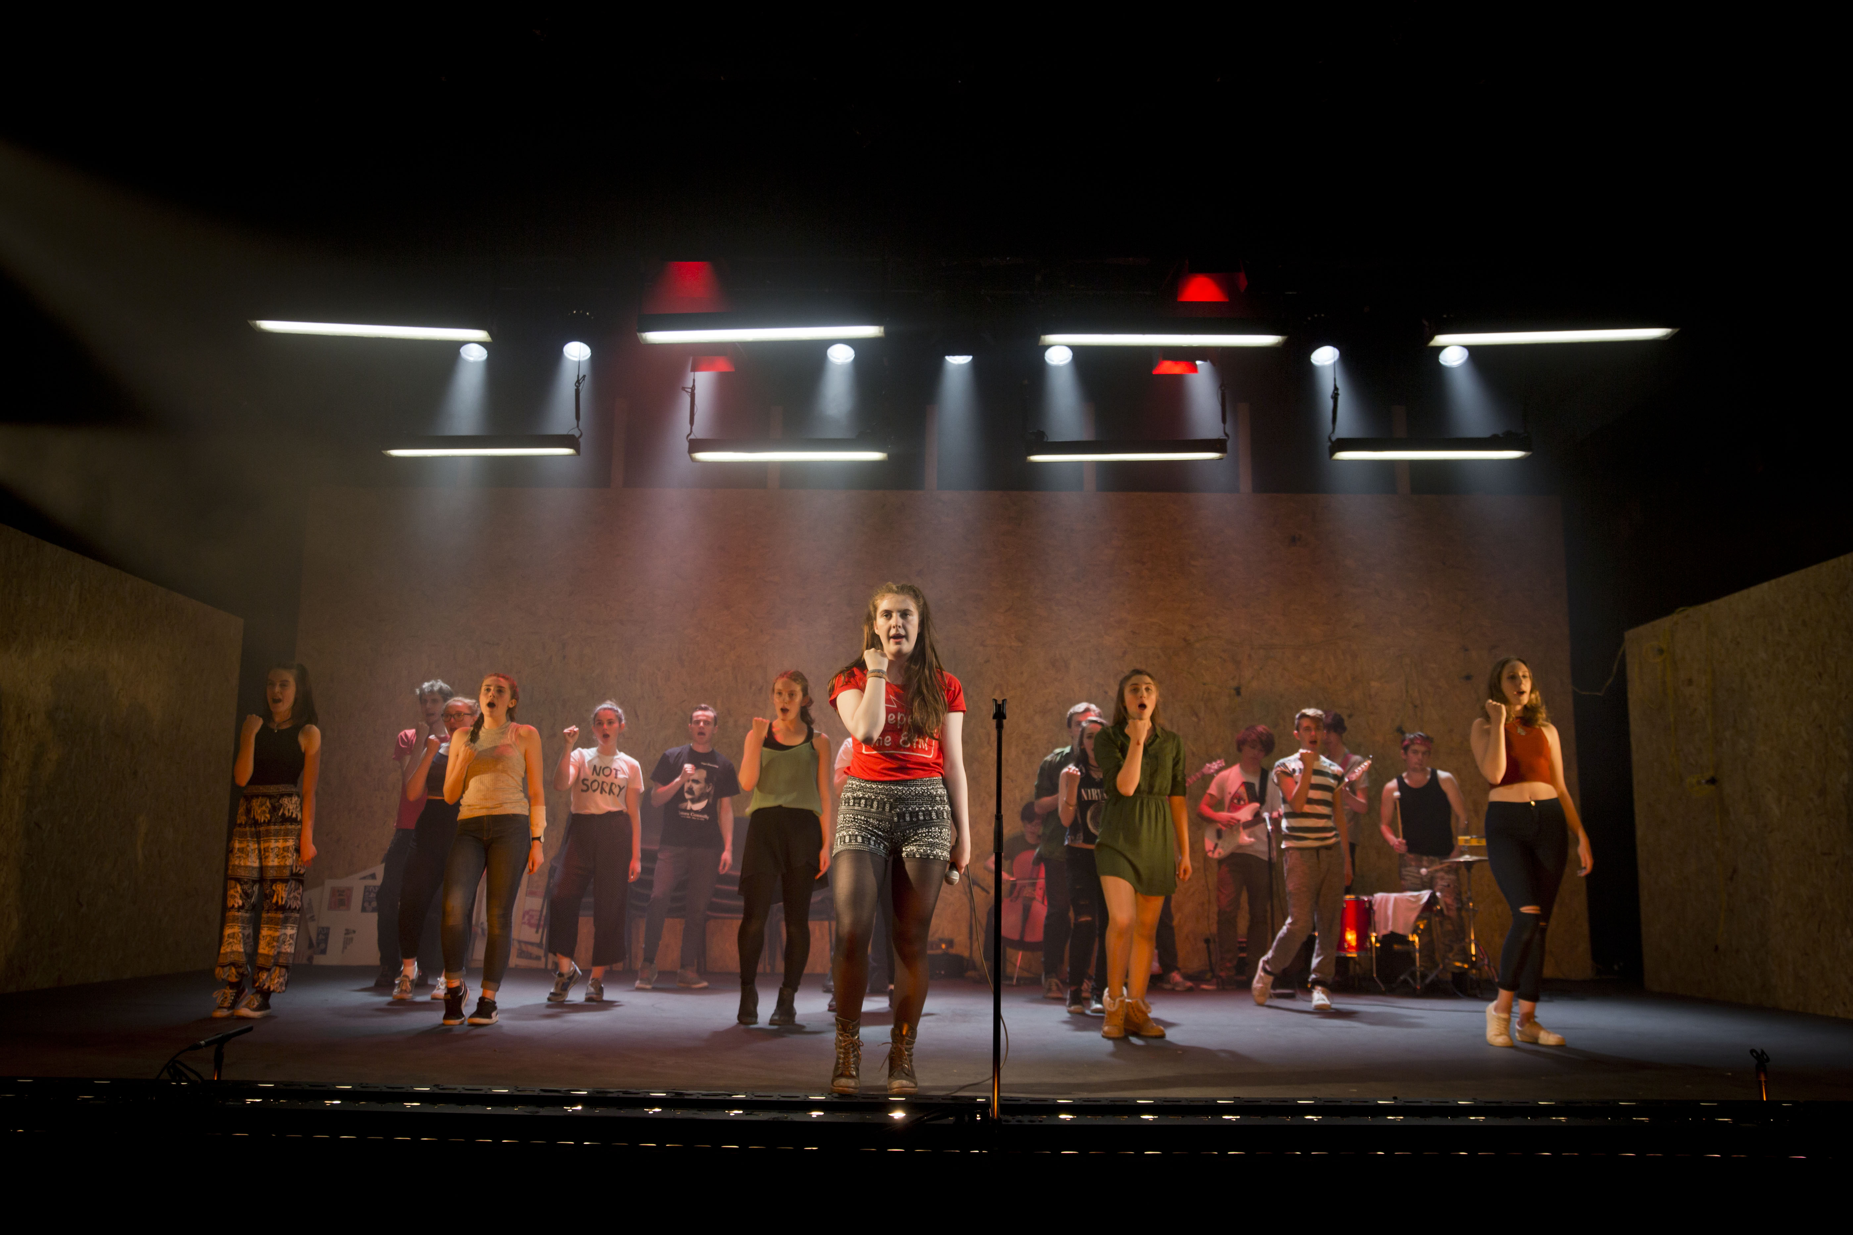

Slide 41
REACTION
Retweeted Willie White (@williewhite)
@DubYouthTheatre's Rising was equal parts heartening and inspiring. The futures of theatre and activism in good hands.
Retweeted Exeunt Magazine (@theatremagazine):
"Maybe this is the generation to rise up" - Dublin Youth Theatre stage a "paean to activism" https://t.co/e20nr5DFP8 https://t.co/3md4LrVe1S

