Slide 1
Nowhere Places: lessons learned regarding teacher education from the DfE ITT Expansion Pilot operationalised in remote coastal schools in South West England
Dr Anne Parfitt - Research Fellow
(Bath Spa University)
Paul Taylor-McCartney – QA Support Tutor & Deputy Programme Manager
(Cornwall SCITT)
TEAN Conference 6th May 2021

Slide 2
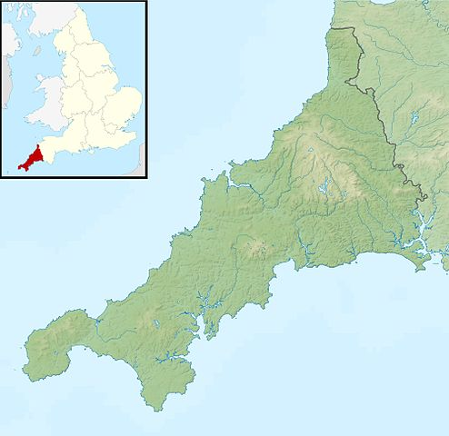
‘Utopia means nowhere or no-place. It has often been taken to mean good place, through confusion of its first syllable with the Greek eu as in euphemism or eulogy’ (Carey, 1999).
Cornwall
Contains Ordnance Survey data © Crown copyright and database right

Slide 3
In our session …
To present summary findings on a (three-year) DfE-funded project based in the SW region.
To reflect on its impact on stakeholders, with reference to social mobility.
Discuss the project and its future.

Slide 4
‘Expansion Pilot’ Project (DfE 2017) ‘Objectives’
Increase trainee supply in areas of poor teacher recruitment and retention.
Improve the supply of newly qualified teachers to category 3 and 4 schools located in challenging areas.
Promote category 3 and 4 school improvement through their involvement in ITT.
Remove obstacles to social mobility.

Slide 5
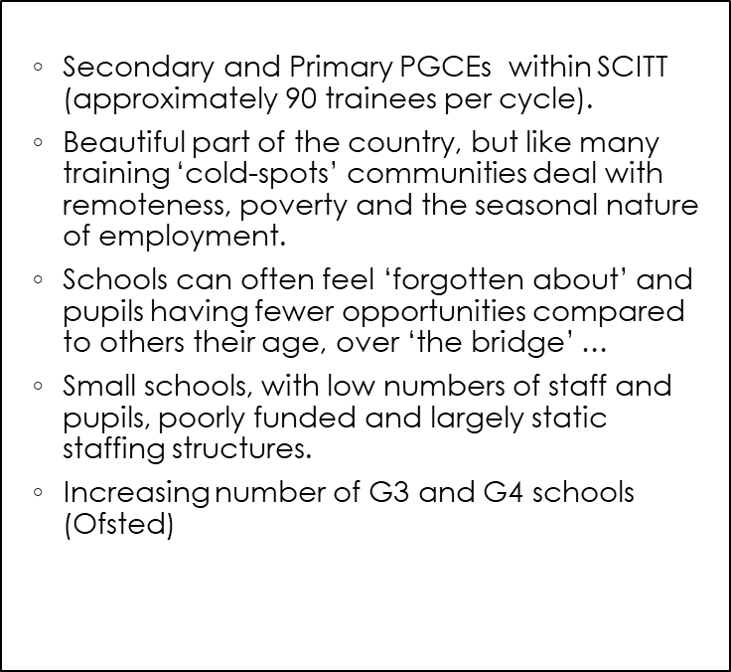
Department for Education. (2017). The Expansion Pilot for Initial Teacher Training (ITT) Provision: an opportunity to support schools in greatest need. Department for Education. (2017). Unlocking talent: fulfilling potential. A plan for improving social mobility through education. House of Lords. (2019). The Future of Seaside Towns. Regenerating Seaside Towns and Communities Select Committee Report of Session 2017–19.
Context

Slide 6
Core Principles: Partnerships and Support
3 partnership schools met the criteria for inclusion (based on the Marine Peninsular, including an island setting).
DfE: project finances/evaluation.
Termly payments to schools (across 3 years) to cover mentoring of PGCE trainees/NQTs, Professional Tutor meetings/training, CPD/training (remote)for all involved.
Cornwall SCITT (appointed a QA Support Tutor at the end of Y1).

Slide 7
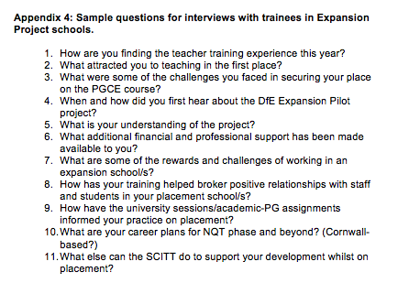
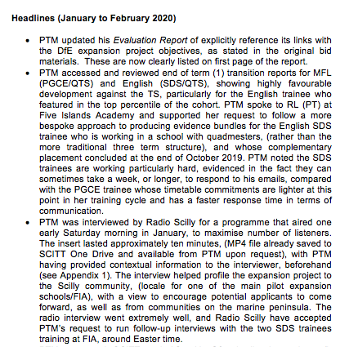
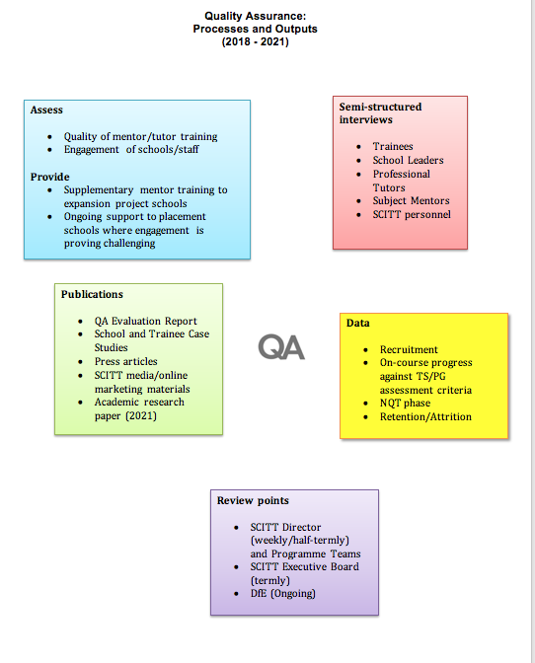
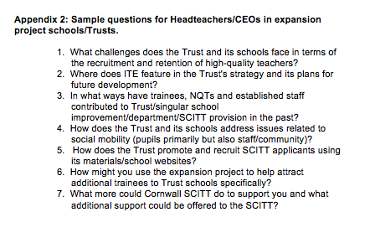
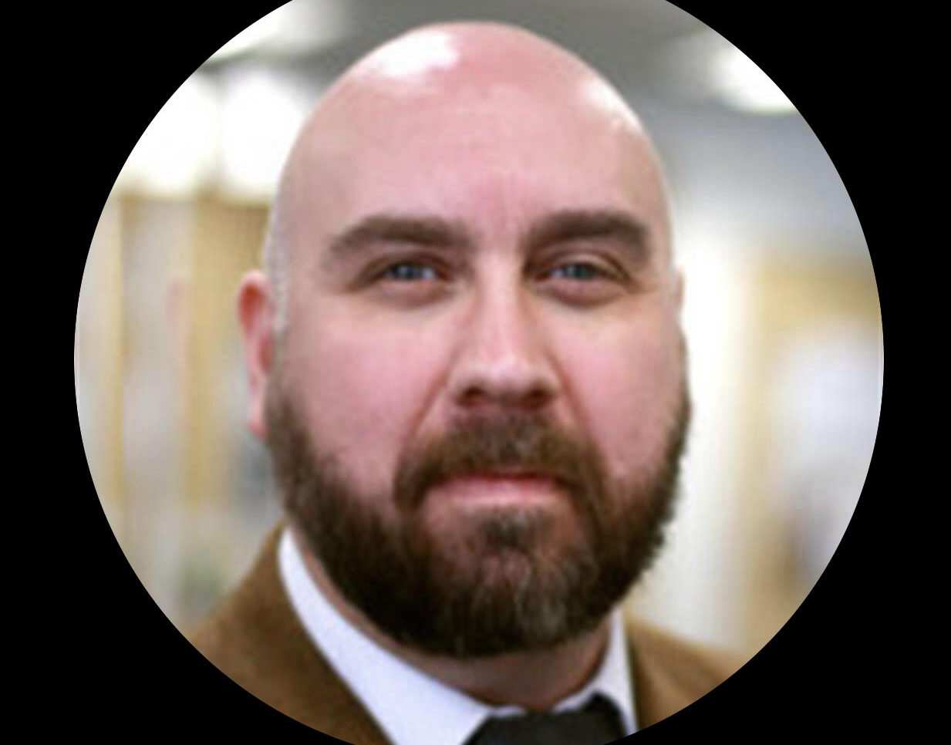
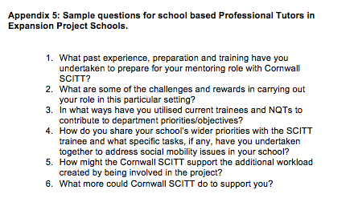
QA Support Tutor Activities

Slide 8
Year 1 (Preparation)
Year 2
(Launch)
Three pilot schools hosting secondary and primary trainees (mostly PGCE, but also SDS (QTS only).
Funding has been used to support trainees with the costs of travel and, where necessary, accommodation, for trainees, but also central trainers - in order to overcome the geographical remoteness of this part of the county; (e.g. Ferry and air travel, car fuel). Hotel and board accommodation for half termly placements across the year).
Development of dedicated online mentor training for expansion pilot schools.
Full range of QA Support Tutor activities, (next slide).
Engagement with pilot schools and eligibility.
SCITT subject offer/school & dept capacity.
No SCITT trainees in Y1 (some NQTs) in pilot schools; 3 trainees in place for Y2 (somewhat short of our target of 15).
Preparations for Y2: school leaders recruited to identify suitable, unqualified teachers – geographical/coastal-specific issues.
Appointment of a QA Support Tutor (1 day per week/two years) to support SCITT leadership/team, QA the pilot schools and evaluate the impact of the project.

Slide 9
Year 3 (Embed)
7 NQTs in EP schools:
School A
NQTs: 3 Secondary English, MFL, Science & 1 Primary
Trainees: 1 Primary SDS
School B
NQTs: 1 Secondary MFL and 1 SEND
School C
NQTs: 1 Secondary Science
Trainees: 2 Secondary MFL
NQT/PT contributions to Annual NQT Conference (January)
PT contribution to SCITT’s EPS session (March)
TEAN Conference (May)
Publication of BERA Blog
Q Sort Survey carried out in EP Schools (BSU)
Range of webinars/CPD for staff in all three EP Schools
Remote lesson observations of NQTs/Trainees in all EP Schools (May)
Visits to EP schools (AP and PTM) – June/July
Offers to support PGCE placements in 2021/222
Formal evaluation for DfE and journal article

Slide 10
Sources on education and place
Gruenewald, D. A. (2003). Foundations of Place: A Multidisciplinary Framework for Place-Conscious Education. American Educational Research Journal, 40(3), 619- 665
Roberts, P. & Green, B. (2013). Researching Rural Places: On Social Justice and Rural Education. Qualitative Enquiry. doi:10.1177/1077800413503795. Schnellert, L. (2020). Place-consciousness and education change networks to empower rural learners. 319-328. In Corbett, M. & Gereluk, D. (Eds.) Rural teacher education: connecting land and people. Springer. Thomson, P. (2000). Like schools, educational disadvantage and ‘thinness’. The Australian Educational Researcher, 27(3), 157–172.
‘Thisness’ in our landscape
Local events/crises in schools e.g. poor Ofsted grade
Long time frame required e.g. 3 years to get EP started
Communication and building networks with many colleagues is essential
Place-conscious teaching practices:
strong resilience e.g. pre-COVID connectivity via IT;
all through schools and even weekly boarding;
curricula using the natural environment;
post-16 opportunities for students a concern.

Slide 11
Meeting the EP’s core objectives?
Increase trainee supply in areas of poor teacher recruitment and retention? √
Improve the supply of newly qualified teachers to category 3 and 4 schools located in challenging areas? √
Promote category 3 and 4 school improvement through their involvement in ITT? √
Remove obstacles to social mobility?* √
Nowhere becomes somewhere, again …

Slide 12
Social Mobility “Social mobility is about ensuring that a person’s occupation and income are not tied to where they started in life. It is also about fairness across society and making sure that people of all backgrounds get equal opportunities in early years, at school, in universities and in work.” In ‘State of the Nation 2018-19: Social Mobility in Great Britain - Summary’
Desired outputs and criteria for success identified by DfE
New teachers
Evidence that objectives 1-3 (see above) have been met are all indicators that obstacles to social mobility have been improved.
Unqualified graduate teacher(s) training to be a teacher as a result of the ITT Expansion pilot
Teaching Assistants with a degree training to be a teacher as a result of the ITT Expansion pilot
Unqualified teachers undertaking the Assessment Only route to gain QTS
School leadership
Teachers undertaking CPD/mentor training to mentor trainees.
Teachers becoming school leaders.
Evidence of school improvement, for example improvement in school Ofsted rating: 4 to 3 or 3 to 2 (or 1)
Improved school governance and leadership

Slide 13
Experiences of ‘EP’ participants …
Professional Tutor
I have a personal determination to improve and raise standards; although due to our location, we have encountered professional isolation in the past.
A challenge for us is building a research-informed culture – remaining current.
Being both Professional Tutor and Subject Mentor at the same time comes with its challenges but was just about workable as only one trainee – it helped that she was excellent … such an inquisitive mind and thirst for knowledge.
Lots of our pupils lack cultural capital; limited access to cultural experiences - particularly international experiences.
Director of SCITT
Per capita funding for the majority of Cornwall schools is very low and so remain hugely underfunded; due to this, many school staff have more than one responsibility.
We pride ourselves on being a service that trains local people who will then become teachers in local schools. A lot of our applicants like this model – and could not afford to travel over the bridge to live away from home and all that implies in terms of costs and being away from home for long periods of time; therefore, we’re clearly providing a vital service for our isolated communities.
Highly skilled trainees in placement schools act as positive role models to communities exhibiting mobility issues and this theme is embedded throughout a programme that is designed to meet the needs of all learners.
Trainee/NQT
Rewards: Amazing experiences each day! I have been privileged to see up close a learner’s journey from Y1 to Y6 .. even then through to KS4 … that is the beauty of being in a ‘through school’.
Special relationship between teacher, pupils and families; privileged role model situation; they trust you so much, and I place so much trust in them.
Challenge: being professional at all times – you cannot be in the pub, have too many drinks – in such a small community everything you do has an impact. That can be good, as well as bad!
How do we make ITE more sustainable in these schools?

Slide 14
Thank You
Paul Taylor-McCartney:
E: pault@truro-penwith.ac.uk
Dr Anne Parfitt:
E: a.parfitt@bathspa.ac.uk
Notes:
Both

Slide 15
References
Department for Education. (2017). The Expansion Pilot for Initial Teacher Training (ITT) Provision Expansion pilot: opportunity to support schools in greatest need. Retrieved from: https://www.gov.uk/government/news/new-education-and-skills-measures-announced
Department for Education. (2017). Unlocking talent: fulfilling potential. A plan for improving social mobility through education.
House of Lords. (2019). The Future of Seaside Towns. Regenerating Seaside Towns and Communities Select Committee Report of Session 2017–19. Retrieved from: https://publications.parliament.uk/pa/ld201719/ldselect/ldseaside/320/320.pdf
Gruenewald, D. A. (2003). Foundations of Place: A Multidisciplinary Framework for Place-Conscious Education. American Educational Research Journal, 40(3), 619-65 https://www.conftool.com/ecer2021/index.php?page=showAbstract&print=yes&doprint=yes&form_id=1725&show_abstract=1 2/2
Lavalley, M. (2018). Out of the Loop: Rural schools are largely left out of research and policy discussions, exacerbating poverty, inequity and isolation. Center for Public Education. National School Boards Association. Virginia, USA.
Parfitt, A. (2020). “Turning around coast-based schools: an interpretive narrative analysis of a report on school reform in English coastal communities.” Improving Schools. doi.org/10.1177/1365480220968744
Roberts, P., and B. Green. (2013). Researching Rural Places: On Social Justice and Rural Education. Qualitative Enquiry. doi:10.1177/1077800413503795.
Schnellert, L. (2020). Place-consciousness and education change networks to empower rural learners. 319-328. In Corbett, M. & Gereluk, D. (Eds.) Rural teacher education: connecting land and people. Springer.
Smyth, J., Wrigley, T. and McInerney, P. (2018). Living on the Edge: Rethinking Poverty, Class and Schooling. Oxford. Peter Lang.
Social Mobility Commission. (2019). State of the Nation 2018-19: Social Mobility in Great Britain.
Thomson, P. (2000). Like schools, educational disadvantage and ‘thisness’. The Australian Educational Researcher, 27(3), 157–172.
White, S., and Corbett, M. (2014). Doing Educational Research in Rural Settings. Routledge.

