Slide 1


Remote Coastal Schools: Providing Teachers to Seaside Communities
Anne Parfitt
Bath Spa University
a.parfitt@bathspa.ac.uk
ECER Ignite Presentation
Wednesday, 8th Sept 2021 11:00am - 12:30pm

Slide 2
Providing Teachers to Seaside Communities
Raise the quality of teaching- raise levels of social mobility
Department for Education. (2017).
Unlocking Talent, Fulfilling Potential:
A plan for improving social mobility through education.
Notes:
Starting in 2017. Govt focus on raising the quality of teaching in order to raise social mobility. Discourse that teachers have the strongest impact on outcomes, ignoring the research that contradicts this.

Slide 3
Pre-service teachers: challenging areas of the country need support to secure new staff
Initial Teacher Training (ITT) Provision Expansion pilot
DfE (2018) Tender Notice
Notes:
Expansion Pilot- a small scale DfE project from July 2018. Aimed to increase availability of new teachers in selected areas. With 1. poor rates of social mobility, 2. weak supply of teachers, 3. schools that were judged through inspection as failing. These are criteria set by metro-normative standards.

Slide 4
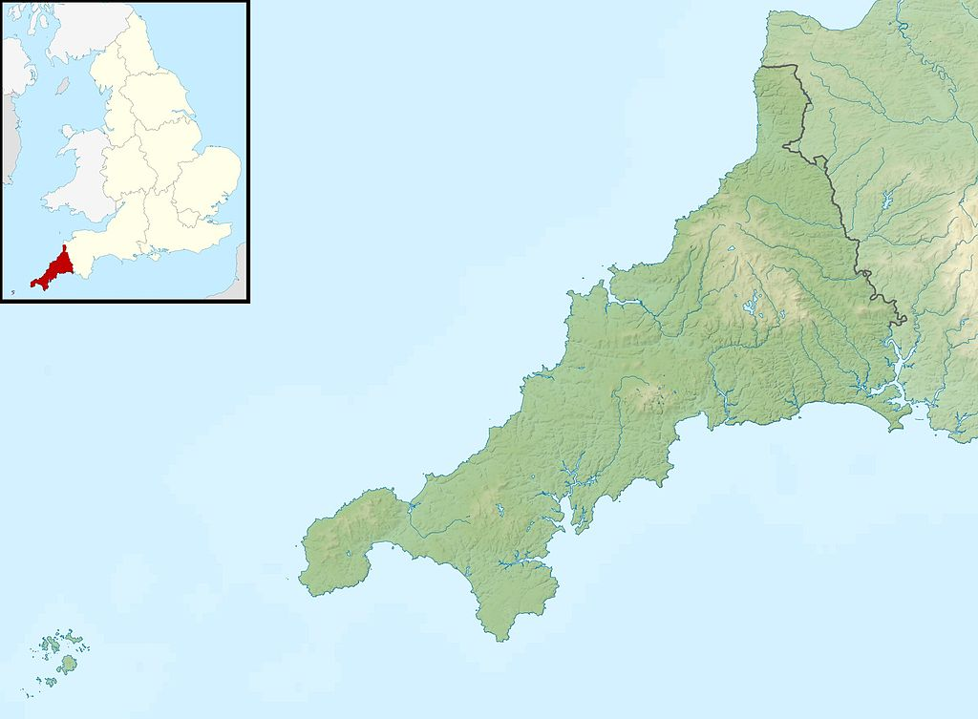
Peninsular schools
Contains OS data © Crown copyright and database right (2021)
OS OpenData is free to use under the Open Government Licence (OGL)
Notes:
Teacher training providers tendered and seven bids were accepted and projects started in rural, urban and coastal locations. The project I focus on today was run in Cornwall by the School Centred Initial teacher Training organization.

Slide 5
Thisness in place
Notes:
Cornwall is a remote place- not as remote as some regions in USA or Australia. However, there are islands communities similar in some respects to Scotland. Marginal economy. Some places socioeconomically left behind while others are highly desirable resorts. Work / employment is precarious and often seasonal. A culturally distinct region with historic ties to Celtic traditions/language.

Slide 6

Challenging landscape
Notes:
The landscape is difficult for teacher recruitment. Stuck workforce. Expensive place to do training. Very small schools. Inaccessible places preventing daily commuting. A proportion of schools are focused on resolving their own improvement strategies after poor inspections and do not/cannot engage with ITT. To join the pilot they could not be doing ITT, as the aim was to get new programmes in fresh territories..

Slide 7

Planning
Notes:
Back to the Expansion Pilot project. Year 1 spent planning in Cornwall. This was to build the trust for the rest of the 3 year project. Recruiting schools to the pilot by the SCITT provider.

Slide 8
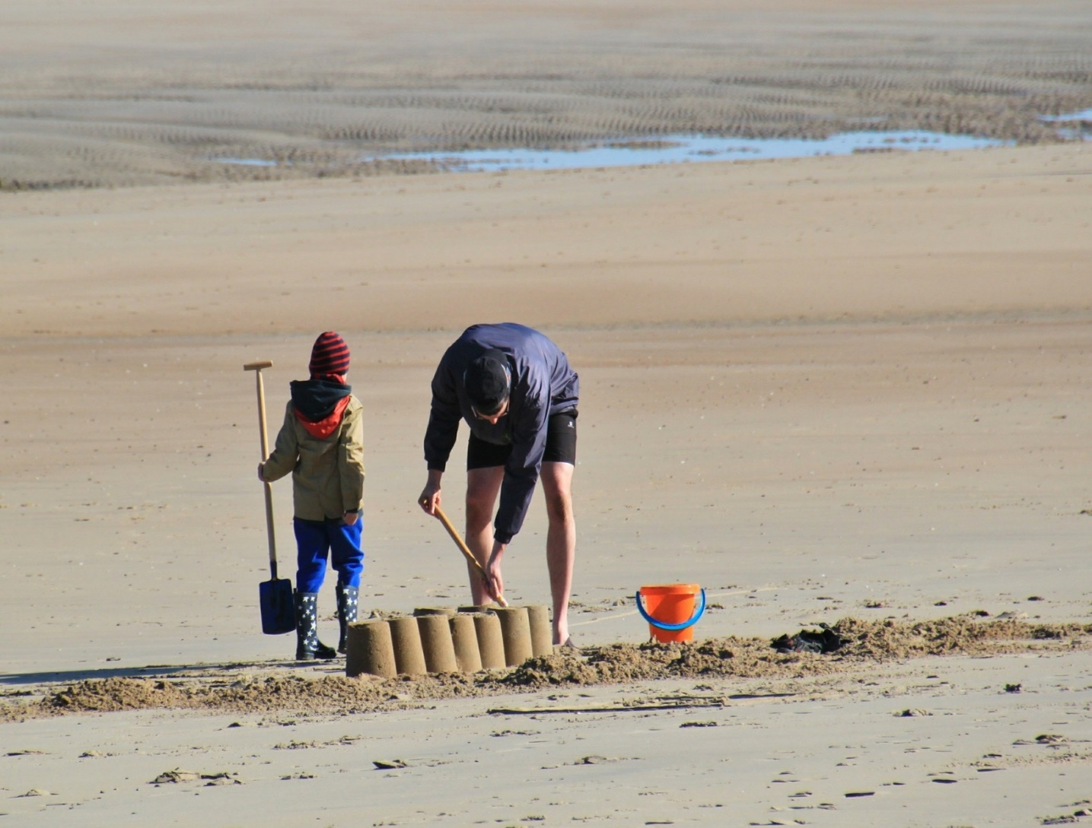
Local expert knowledge
Notes:
All 7 pilot providing organisations were local. They were close to their community where they were putting trainees. No big players eg Teach First. Some were SCITTS some others were local university providers.

Slide 9

Deep pockets (£££)
Notes:
The pilot was funded by DfE for 3 years. Total £3million. Not a lot compared with other projects. Moreover, each school had not had trainees for several years and were starting over. The funds were spent on putting each trainee into ‘an inexperienced school setting’. This was a bespoke package and took money and time to set up. EG. Trainee’s travel to work/to training events, local accommodation, specialist modules of training. Buy-out for mentors in schools. SCITT provider tutor’s time.

Slide 10

Partnerships
Notes:
The Cornwall pilot was set up and managed by people who had lived and worked most of their lives in the region. Informal understanding of the way of life. Longstanding work networks. Understanding of each school’s history and local politics. They were able to convince the schools that they were sincere in offering the money to fund the training of new teachers.

Slide 11

Building programmes
Notes:
Across the 3 years, in the Cornwall case, 7 new teachers were supported and are now available to the school leaders to recruit. Many had been in the area working as classroom aides or teaching assistants. Unlikely to leave the area. A new resource of trained and post grad level educated young people who can contribute to their communities.

Slide 12
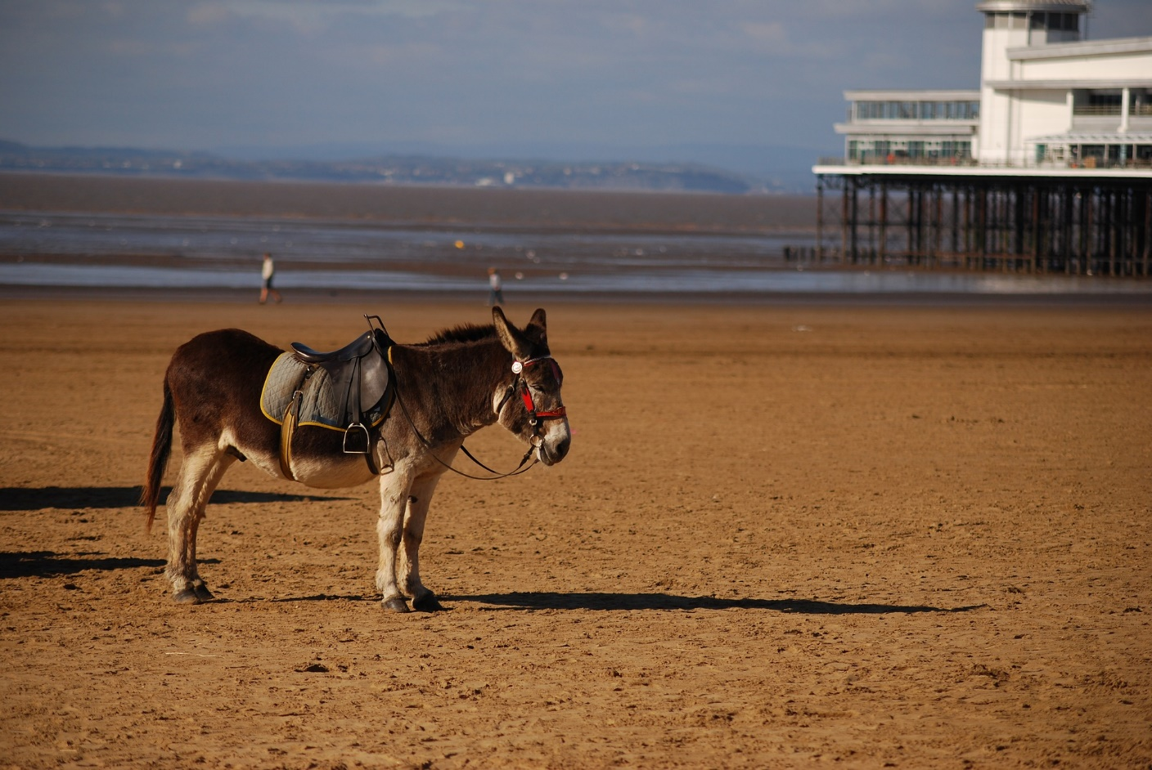
Stubborn issues
Notes:
The Pilot nationally had vague targets-double edged in that value for money is difficult to demonstrate.
The complexities of working with the relations with schools requires skillful staff to be deployed by the providers- they are already very busy people.
No previous experiences of similar pilots to draw on so difficult to budget for unknown eventualities.
Schools are in fragile circumstances- open to re- inspection at any time.
In small schools all staff take on many responsibilities as there are few of them to share the burdens of management and leadership.

Slide 13
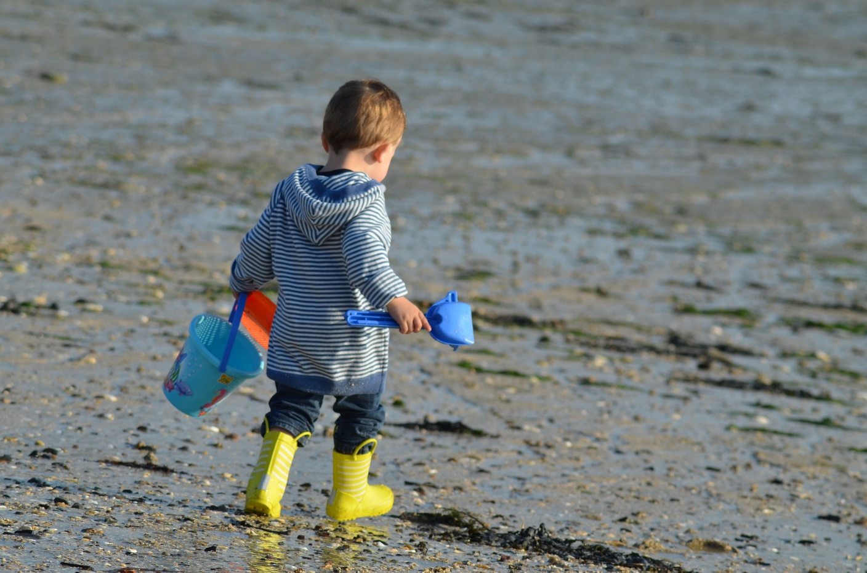
Determination
Notes:
Educators have been committed to making the Pilot projects work in the different schools. The money is a welcomed opportunity to get new talent and fresh ideas into their school communities. There were chances to work remotely and show how this can be continued for CPD in the future.. Trainees’ teaching combined the outdoors environments - built resilience and new capabilities in students.
Students met new young teachers bringing new perspectives on the world to small remote places’ classrooms.

Slide 14
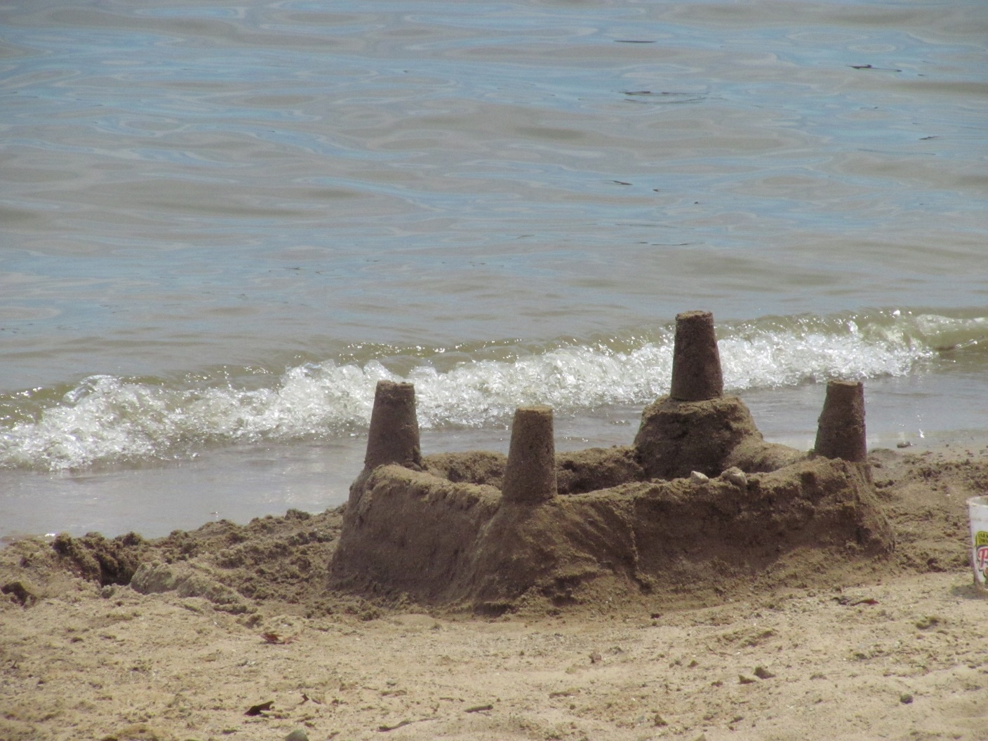
Vulnerable
Notes:
The Pilot was only ever scheduled to run for just under 3 years. There was no planned follow up or any more funding possible. The schools remain small and may not be able to actually employ more members of staff–even when they are qualified as teachers.
The loss of a key player can end the pilot’s networked partnerships. E.g. sickness or moving on to new schools.
The loss of one key teacher can mean the project in a school may not be able to mentor the trainees.

Slide 15

Changes on the horizon
Notes:
The Pilot was a one off initiative funded for localised action by local experts collaborating.
The other place-based initiative the Opportunity Areas have been running in 12 areas across UK for similar length of time with £72m funding to date. These are top down and involve major national players moving into a school community to ‘turn them around’.

Slide 16
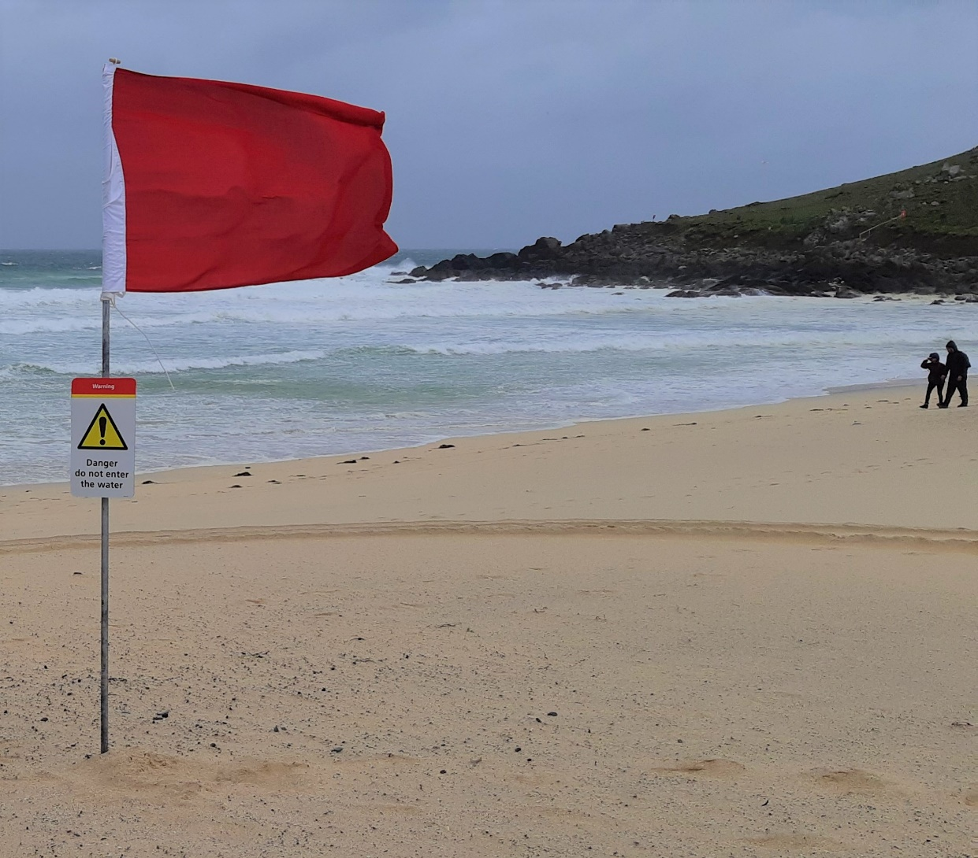
Warnings
Notes:
The role of the local providers for all teacher training is nationally currently questioned. Warnings are being heard across the sector as there is a Sector Market Review being undertaken.

Slide 17

Tide runs out
Notes:
The Pilot has shown the benefits of careful working with knowledgeable educators who know the thisness of the Cornish peninsular schools. While the tide was in and the money was available, the schools themselves reported feeling looked after – rather than forgotten by central government. What of the future?

Slide 18
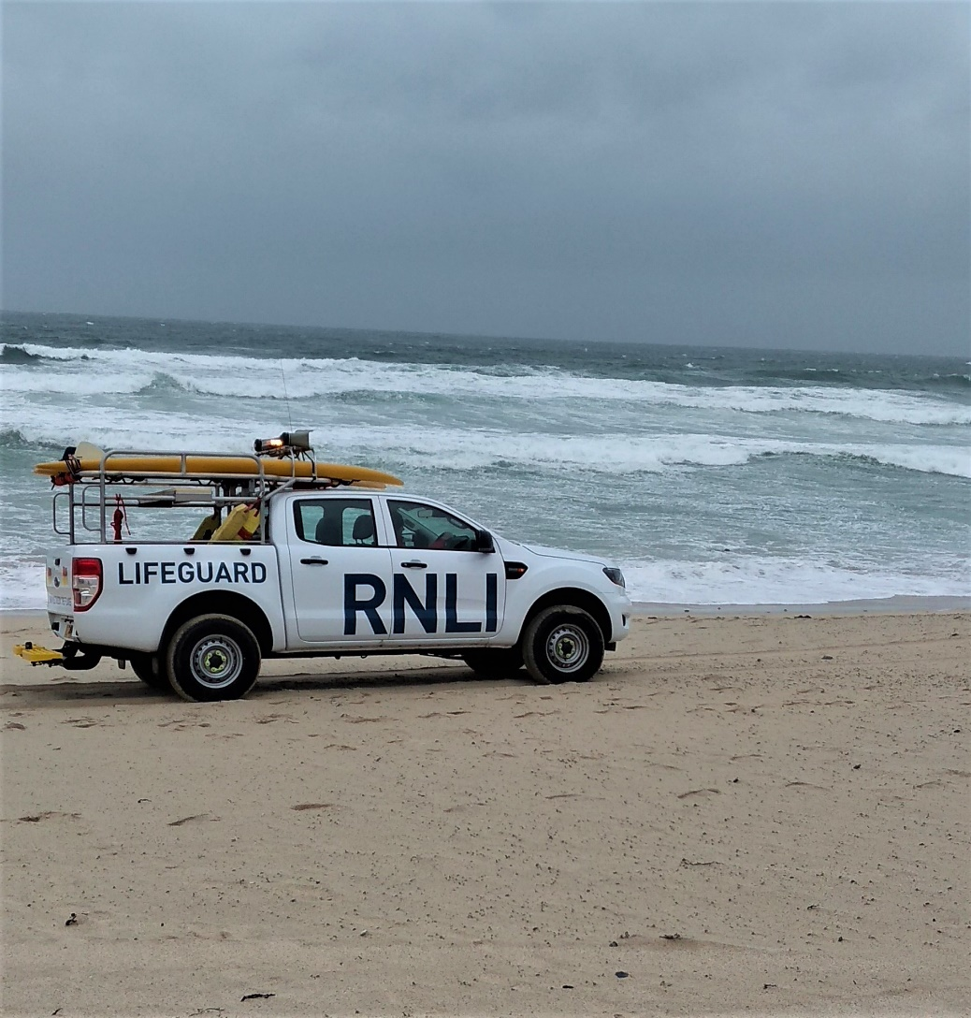
Driving onwards…
Notes:
Claim remains that government is improving social mobility and rescues remote communities from their socioeconomic deprivation via schools. ‘Levelling Up’?
How effective can this be when the focus remains on the schools rather than addressing the local socioeconomic environment? How can the schools show that they are improving if the standards by which they are measured are metro-normative and not reflecting the specifies of place?

Slide 19
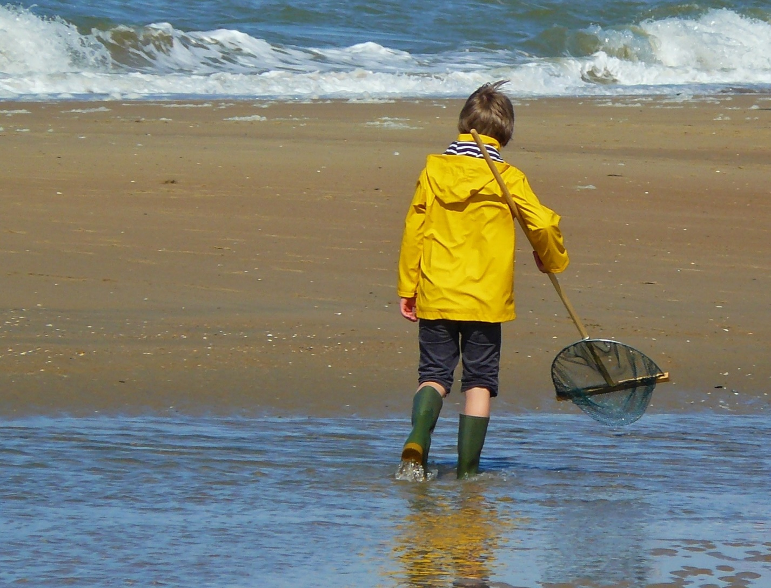
Looking to the future?
Notes:
Where next for shaping these schools in the South West Peninsular?

Slide 20
References
Parfitt A. and Taylor-McCartney, P. (2021). Interrogating the notion of the seaside idyll https://www.bera.ac.uk/blog/interrogating-the-notion-of-the-seaside-idyll-in-the-context-of-initial-teacher-training
Roberts, P. and Green, B. (2013). Researching Rural Places: On Social Justice and Rural Education Qualitative Inquiry 19 (10) 765 –774 DOI: 10.1177/1077800413503795
Smyth, J., Wrigley, T. and McInerney, P. (2018). Living on the Edge: Rethinking Poverty, Class and Schooling. Oxford. Peter Lang.
Thomson, P. (2000). Like schools, educational disadvantage and ‘thisness’. The Australian Educational Researcher, 27(3), 157–172

